Slide 1

COMS W4111 - Introduction to Databases
(Module II) DBMS Architecture and Implementation: Transactions, Query Processing NoSQL, Part 1
Donald F. Ferguson (dff@cs.columbia.edu)
Lecture 9: Transactions, Query Processing, NoSQL

Slide 2

We will start in a few minutes.
2 | Introduction to Databases (F20): Lecture 9: Transactions, Query Processing, NoSQL

Slide 3
Module II – Context
3 | Introduction to Databases (F20): Lecture 9: Transactions, Query Processing, NoSQL

Slide 4
Module II – Context
Repeating that the DB faculty encouraged reducing time spent on Module II concepts to enable including more broadly relevant material.
Approach: Module II content based on slides.
239 slides worth of material.
I have found that 3 minutes per slide is a reasonable average,
and there are 239 slides (12 hours of material), and
I want to confine to the 1st half of the session.
I am going to fly through material today and highlight slides/concepts that I think are especially interesting or important.
I will ask you questions on homework 3 and the final exam that
May require reading some sections in the textbook.
Thinking about the material to answer.
To ensure that you internalized some concepts.

Slide 5
Completing Disks, I/O, Indexes
5 | Introduction to Databases (F20): Lecture 9: Transactions, Query Processing, NoSQL

Slide 6
Records and Files Reminder and Conclusion Row versus Column
Completing Disks, I/O, Indexes
6 | Introduction to Databases (F20): Lecture 9: Transactions, Query Processing, NoSQL

Slide 7
Reminder: Table, Tuple, File, Block, Record
Some terms:
A block is a chunk of storage and the unit of of transfer between memory and a disk.
A file is a collection of blocks (used blocks, free blocks).
A block contains free space (to hold records) and records.
A row/tuple is a record. Normally, a row is stored and transferred as a unit.
Reading or writing a block involves:
Seek
Rotate
Transfer latency
Reading and writing a byte requires reading and writing a block.

Slide 8
Organization of Records in Files
Heap – record can be placed anywhere in the file where there is space
Sequential – store records in sequential order, based on the value of the search key of each record
In a multitable clustering file organization records of several different relations can be stored in the same file
Motivation: store related records on the same block to minimize I/O
B⁺-tree file organization
Ordered storage even with inserts/deletes
More on this in Chapter 14
Hashing – a hash function computed on search key; the result specifies in which block of the file the record should be placed
More on this in Chapter 14

Slide 9
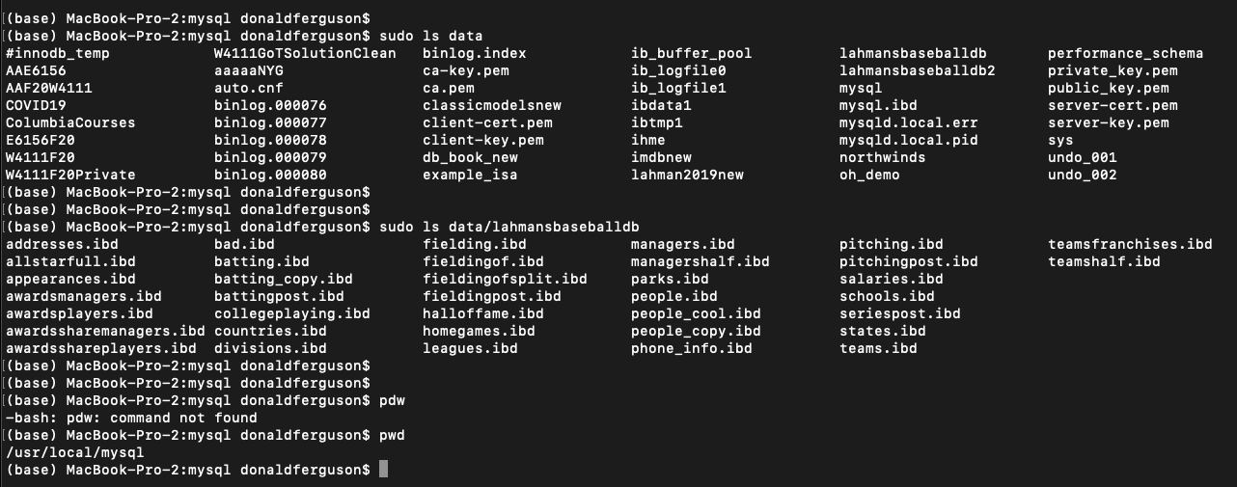
Reminder: Table, Tuple, File, Block, Record

Slide 10
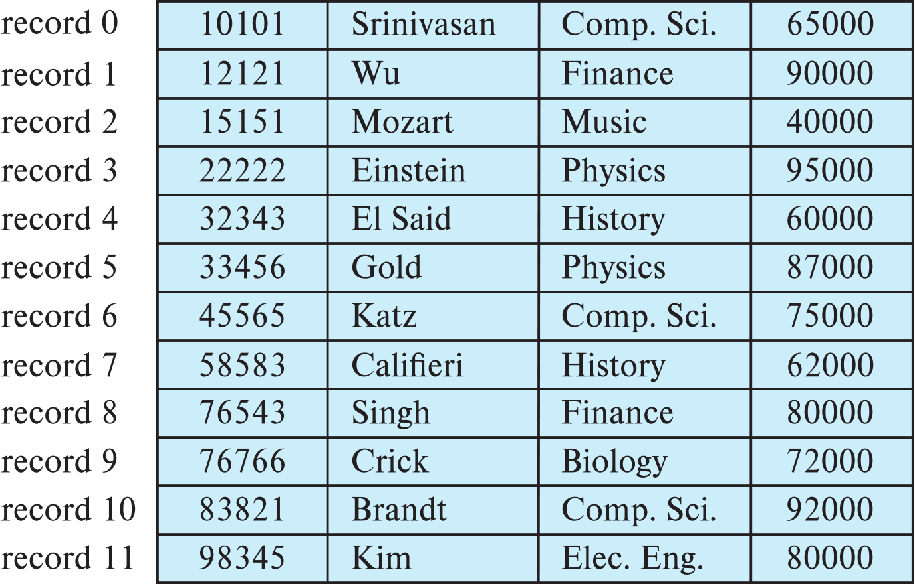
Fixed-Length Records (Example)
Simple approach:
Store record i starting from byte n ∗ (i – 1), where n is the size of each record.
Record access is simple but records may cross blocks
Modification: do not allow records to cross block boundaries
Fixed Length
Variable Length
Variable Format
... ...
Blocks

Slide 11
Course Focus

Slide 12
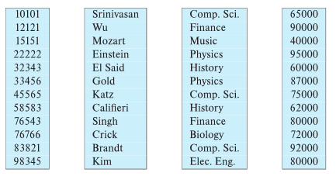
Column-Oriented Storage
Also known as columnar representation
Store each attribute of a relation separately
Example

Slide 13
Columnar Representation
Benefits:
Reduced IO if only some attributes are accessed
Improved CPU cache performance
Improved compression
Vector processing on modern CPU architectures
Drawbacks
Cost of tuple reconstruction from columnar representation
Cost of tuple deletion and update
Cost of decompression
Columnar representation found to be more efficient for decision support than row-oriented representation
Traditional row-oriented representation preferable for transaction processing
Some databases support both representations
Called hybrid row/column stores

Slide 14
Buffers, Buffer Pools
Completing Disks, I/O, Indexes
14 | Introduction to Databases (F20): Lecture 9: Transactions, Query Processing, NoSQL

Slide 15
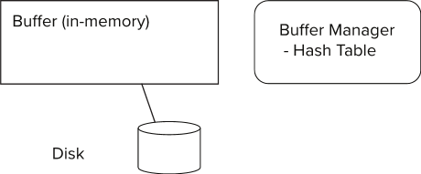
Storage Access
Blocks are units of both storage allocation and data transfer.
Database system seeks to minimize the number of block transfers between the disk and memory. We can reduce the number of disk accesses by keeping as many blocks as possible in main memory.
Buffer – portion of main memory available to store copies of disk blocks.
Buffer manager – subsystem responsible for allocating buffer space in main memory.
Notes:
15

Slide 16
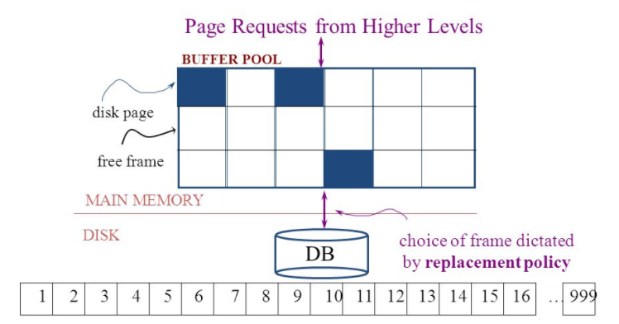
The Logical Concept
The DBMS and queries can only manipulate in-memory blocks and records.
A very, very, very small fraction of all blocks fit in memory.

Slide 17
Buffer Manager
Programs call on the buffer manager when they need a block from disk.
If the block is already in the buffer, buffer manager returns the address of the block in main memory
If the block is not in the buffer, the buffer manager
Allocates space in the buffer for the block
Replacing (throwing out) some other block, if required, to make space for the new block.
Replaced block written back to disk only if it was modified since the most recent time that it was written to/fetched from the disk.
Reads the block from the disk to the buffer, and returns the address of the block in main memory to requester.
Notes:
17

Slide 18
Buffer Manager
Buffer replacement strategy (details coming up!)
Pinned block: memory block that is not allowed to be written back to disk
Pin done before reading/writing data from a block
Unpin done when read /write is complete
Multiple concurrent pin/unpin operations possible
Keep a pin count, buffer block can be evicted only if pin count = 0
Shared and exclusive locks on buffer
Needed to prevent concurrent operations from reading page contents as they are moved/reorganized, and to ensure only one move/reorganize at a time
Readers get shared lock, updates to a block require exclusive lock
Locking rules:
Only one process can get exclusive lock at a time
Shared lock cannot be concurrently with exclusive lock
Multiple processes may be given shared lock concurrently

Slide 19
A Whirlwind Tour of Indexes (Database Systems Concepts, V7, Ch. 14)
19 | Introduction to Databases (F20): Lecture 9: Transactions, Query Processing, NoSQL

Slide 20
Basic Concepts
Indexing mechanisms used to speed up access to desired data.
E.g., author catalog in library
Search Key - attribute to set of attributes used to look up records in a file.
An index file consists of records (called index entries) of the form
Index files are typically much smaller than the original file
Two basic kinds of indices:
Ordered indices: search keys are stored in sorted order
Hash indices: search keys are distributed uniformly across “buckets” using a “hash function”.
search-key
pointer

Slide 21
Ordered Indices
In an ordered index, index entries are stored sorted on the search key value.
Clustering index: in a sequentially ordered file, the index whose search key specifies the sequential order of the file.
Also called primary index
The search key of a primary index is usually but not necessarily the primary key.
Secondary index: an index whose search key specifies an order different from the sequential order of the file. Also called nonclustering index.
Index-sequential file: sequential file ordered on a search key, with a clustering index on the search key.

Slide 22
Dense Index Files
Dense index — Index record appears for every search-key value in the file.
E.g. index on ID attribute of instructor relation

Slide 23
Dense Index Files (Cont.)
Dense index on dept_name, with instructor file sorted on dept_name

Slide 24
Sparse Index Files
Sparse Index: contains index records for only some search-key values.
Applicable when records are sequentially ordered on search-key
To locate a record with search-key value K we:
Find index record with largest search-key value < K
Search file sequentially starting at the record to which the index record points

Slide 25
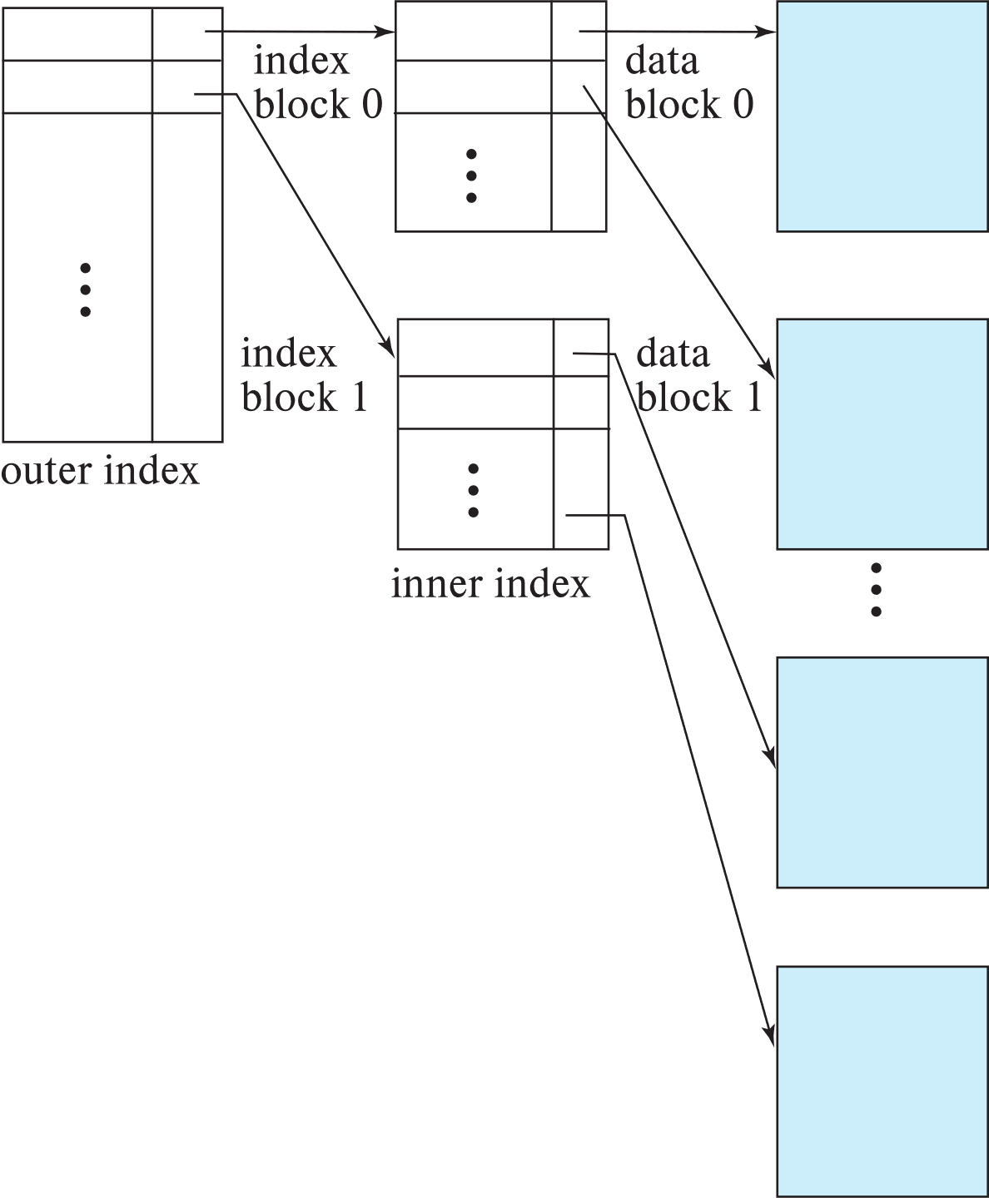
Sparse Index Files (Cont.)
Compared to dense indices:
Less space and less maintenance overhead for insertions and deletions.
Generally slower than dense index for locating records.
Good tradeoff:
for clustered index: sparse index with an index entry for every block in file, corresponding to least search-key value in the block.
For unclustered index: sparse index on top of dense index (multilevel index)

Slide 26
Secondary Indices Example
Secondary index on salary field of instructor
Index record points to a bucket that contains pointers to all the actual records with that particular search-key value.
Secondary indices have to be dense

Slide 27
Clustering vs Nonclustering Indices
Indices offer substantial benefits when searching for records.
BUT: indices imposes overhead on database modification
when a record is inserted or deleted, every index on the relation must be updated
When a record is updated, any index on an updated attribute must be updated
Sequential scan using clustering index is efficient, but a sequential scan using a secondary (nonclustering) index is expensive on magnetic disk
Each record access may fetch a new block from disk
Each block fetch on magnetic disk requires about 5 to 10 milliseconds

Slide 28
Indices on Multiple Keys
Composite search key
E.g., index on instructor relation on attributes (name, ID)
Values are sorted lexicographically
E.g. (John, 12121) < (John, 13514) and (John, 13514) < (Peter, 11223)
Can query on just name, or on (name, ID)
(nameLast, nameFirst, birthyear)
nameLast [nameLast = “Ferguson”] [nameLast like “Fer%”]
nameLast, nameFirst
nameLast, nameFirst, birthyear
NOT and index on
nameFirst, nameLast
birthyear
nameLast like [%er%]

Slide 29
B⁺-Tree Index Files
Disadvantage of indexed-sequential files
Performance degrades as file grows, since many overflow blocks get created.
Periodic reorganization of entire file is required.
Advantage of B⁺-tree index files:
Automatically reorganizes itself with small, local, changes, in the face of insertions and deletions.
Reorganization of entire file is not required to maintain performance.
(Minor) disadvantage of B⁺-trees:
Extra insertion and deletion overhead, space overhead.
Advantages of B⁺-trees outweigh disadvantages
B⁺-trees are used extensively

Slide 30
Example of B⁺-Tree

Slide 31
B⁺-Tree Index Files (Cont.)
A B⁺-tree is a rooted tree satisfying the following properties:
All paths from root to leaf are of the same length
Each node that is not a root or a leaf has between ⎡n/2⎤ and n children.
A leaf node has between ⎡(n–1)/2⎤ and n–1 values
Special cases:
If the root is not a leaf, it has at least 2 children.
If the root is a leaf (that is, there are no other nodes in the tree), it can have between 0 and (n–1) values.

Slide 32
B⁺-Tree Node Structure
Typical node
K_{i} are the search-key values
P_{i} are pointers to children (for non-leaf nodes) or pointers to records or buckets of records (for leaf nodes).
The search-keys in a node are ordered
K₁ < K₂ < K₃ < . . . < K_{n–1}
(Initially assume no duplicate keys, address duplicates later)

Slide 33
Leaf Nodes in B⁺-Trees
Properties of a leaf node:
For i = 1, 2, . . ., n–1, pointer P_{i} points to a file record with search-key value K_{i},
If L_{i}, L_{j} are leaf nodes and i < j, L_{i}’s search-key values are less than or equal to L_{j}’s search-key values
P_{n} points to next leaf node in search-key order

Slide 34
Non-Leaf Nodes in B⁺-Trees
Non leaf nodes form a multi-level sparse index on the leaf nodes. For a non-leaf node with m pointers:
All the search-keys in the subtree to which P₁ points are less than K₁
For 2 ≤ i ≤ n – 1, all the search-keys in the subtree to which P_{i} points have values greater than or equal to K_{i–1} and less than K_{i}
All the search-keys in the subtree to which P_{n} points have values greater than or equal to K_{n–1}
General structure

Slide 35
Example of B⁺-tree
B⁺-tree for instructor file (n = 6)
Leaf nodes must have between 3 and 5 values (⎡(n–1)/2⎤ and n –1, with n = 6).
Non-leaf nodes other than root must have between 3 and 6 children (⎡(n/2⎤ and n with n =6).
Root must have at least 2 children.

Slide 36
Observations about B⁺-trees
Since the inter-node connections are done by pointers, “logically” close blocks need not be “physically” close.
The non-leaf levels of the B⁺-tree form a hierarchy of sparse indices.
The B⁺-tree contains a relatively small number of levels
Level below root has at least 2* ⎡n/2⎤ values
Next level has at least 2* ⎡n/2⎤ * ⎡n/2⎤ values
.. etc.
If there are K search-key values in the file, the tree height is no more than ⎡ log_{⎡n/2⎤}(K)⎤
thus searches can be conducted efficiently.
Insertions and deletions to the main file can be handled efficiently, as the index can be restructured in logarithmic time (as we shall see).

Slide 37
Show the Simulator
https://www.cs.usfca.edu/~galles/visualization/BPlusTree.html

Slide 38
Hashing

Slide 39
Static Hashing
A bucket is a unit of storage containing one or more entries (a bucket is typically a disk block).
we obtain the bucket of an entry from its search-key value using a hash function
Hash function h is a function from the set of all search-key values K to the set of all bucket addresses B.
Hash function is used to locate entries for access, insertion as well as deletion.
Entries with different search-key values may be mapped to the same bucket; thus entire bucket has to be searched sequentially to locate an entry.
In a hash index, buckets store entries with pointers to records
In a hash file-organization buckets store records

Slide 40
Handling of Bucket Overflows (Cont.)
Overflow chaining – the overflow buckets of a given bucket are chained together in a linked list.
Above scheme is called closed addressing (also called closed hashing or open hashing depending on the book you use)
An alternative, called open addressing (also called open hashing or closed hashing depending on the book you use) which does not use over- flow buckets, is not suitable for database applications.

Slide 41
Example of Hash File Organization
Hash file organization of instructor file, using dept_name as key.

Slide 42
Deficiencies of Static Hashing
In static hashing, function h maps search-key values to a fixed set of B of bucket addresses. Databases grow or shrink with time.
If initial number of buckets is too small, and file grows, performance will degrade due to too much overflows.
If space is allocated for anticipated growth, a significant amount of space will be wasted initially (and buckets will be underfull).
If database shrinks, again space will be wasted.
One solution: periodic re-organization of the file with a new hash function
Expensive, disrupts normal operations
Better solution: allow the number of buckets to be modified dynamically.

Slide 43
Show the Simulator
http://iswsa.acm.org/mphf/openDSAPerfectHashAnimation/perfectHashAV.html
https://opendsa-server.cs.vt.edu/ODSA/AV/Development/hashAV.html
nameLast=“Ferguson”
nameLast >= “Ferguson” and nameLast <= “Guthrie”
Select * from professors join students using (uni)
O(N)*O(M) → O(N*M)
O(N)+O(M)+O(1)*O(N) --> O(N+M)

Slide 44
Query Processing
44 | Introduction to Databases (F18): Lecture 10 Query Processing. Transactions, Recovery

Slide 45
Query Processing Overview
Completing Disks, I/O, Indexes
45 | Introduction to Databases (F20): Lecture 9: Transactions, Query Processing, NoSQL

Slide 46
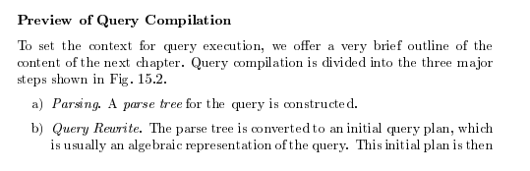
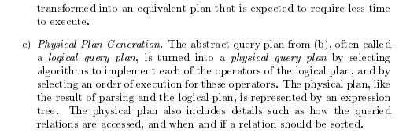
Query Compilation
Database Systems: The Complete Book (2nd Edition) 2nd Edition
by Hector Garcia-Molina (Author), Jeffrey D. Ullman (Author), Jennifer Widom (Author)

Slide 47
Parsing and Execution
Parser/Translator
Verifies syntax correctness and generates a parse tree.
Converts to logical plan tree that defines how to execute the query.
Tree nodes are operator(tables, parameters)
Edges are the flow of data “up the tree” from node to node.
Optimizer
Modifies the logical plan to define an improved execution.
Query rewrite/transformation.
Determines how to choose among multiple implementations of operators.
Engine
Executes the plan
May modify the plan to optimize execution, e.g. using indexes.

Slide 48
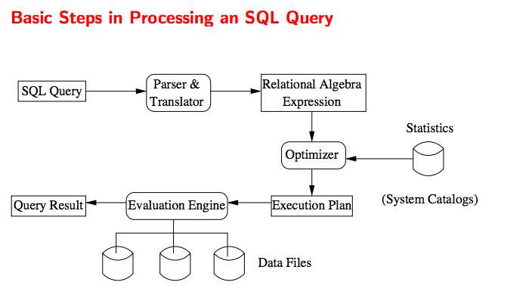
Query Processing Overview

Slide 49
Chapter 15 From the Book
Completing Disks, I/O, Indexes
49 | Introduction to Databases (F20): Lecture 9: Transactions, Query Processing, NoSQL

Slide 50
Chapter 15: Query Processing

Slide 51
Chapter 15: Query Processing
Overview
Measures of Query Cost
Selection Operation
Sorting
Join Operation
Other Operations
Evaluation of Expressions

Slide 52
Basic Steps in Query Processing
1. Parsing and translation
2. Optimization
3. Evaluation

Slide 53
Basic Steps in Query Processing (Cont.)
Parsing and translation
translate the query into its internal form. This is then translated into relational algebra.
Parser checks syntax, verifies relations
Evaluation
The query-execution engine takes a query-evaluation plan, executes that plan, and returns the answers to the query.

Slide 54
Basic Steps in Query Processing: Optimization
A relational algebra expression may have many equivalent expressions
E.g., σ_{salary<75000}(∏_{salary}(instructor)) is equivalent to ∏_{salary}(σ_{salary<75000}(instructor))
Each relational algebra operation can be evaluated using one of several different algorithms
Correspondingly, a relational-algebra expression can be evaluated in many ways.
Annotated expression specifying detailed evaluation strategy is called an evaluation-plan. E.g.,:
Use an index on salary to find instructors with salary < 75000,
Or perform complete relation scan and discard instructors with salary ≥ 75000

Slide 55
Basic Steps: Optimization (Cont.)
Query Optimization: Amongst all equivalent evaluation plans choose the one with lowest cost.
Cost is estimated using statistical information from the database catalog
e.g.. number of tuples in each relation, size of tuples, etc.
In this chapter we study
How to measure query costs
Algorithms for evaluating relational algebra operations
How to combine algorithms for individual operations in order to evaluate a complete expression
In Chapter 16
We study how to optimize queries, that is, how to find an evaluation plan with lowest estimated cost

Slide 56
Measures of Query Cost
Many factors contribute to time cost
disk access, CPU, and network communication
Cost can be measured based on
response time, i.e. total elapsed time for answering query, or
total resource consumption
We use total resource consumption as cost metric
Response time harder to estimate, and minimizing resource consumption is a good idea in a shared database
We ignore CPU costs for simplicity
Real systems do take CPU cost into account
Network costs must be considered for parallel systems
We describe how estimate the cost of each operation
We do not include cost to writing output to disk

Slide 57
Measures of Query Cost
Disk cost can be estimated as:
Number of seeks * average-seek-cost
Number of blocks read * average-block-read-cost
Number of blocks written * average-block-write-cost
For simplicity we just use the number of block transfers from disk and the number of seeks as the cost measures
t_{T} – time to transfer one block
Assuming for simplicity that write cost is same as read cost
t_{S} – time for one seek
Cost for b block transfers plus S seeks b * t_{T} + S * t_{S}
t_{S} and t_{T} depend on where data is stored; with 4 KB blocks:
High end magnetic disk: t_{S} = 4 msec and t_{T} =0.1 msec
SSD: t_{S} = 20-90 microsec and t_{T} = 2-10 microsec for 4KB

Slide 58
Measures of Query Cost (Cont.)
Required data may be buffer resident already, avoiding disk I/O
But hard to take into account for cost estimation
Several algorithms can reduce disk IO by using extra buffer space
Amount of real memory available to buffer depends on other concurrent queries and OS processes, known only during execution
Worst case estimates assume that no data is initially in buffer and only the minimum amount of memory needed for the operation is available
But more optimistic estimates are used in practice
Notes:
58

Slide 59
Selection Operation
File scan
Algorithm A1 (linear search). Scan each file block and test all records to see whether they satisfy the selection condition.
Cost estimate = b_{r} block transfers + 1 seek
b_{r} denotes number of blocks containing records from relation r
If selection is on a key attribute, can stop on finding record
cost = (b_{r} /2) block transfers + 1 seek
Linear search can be applied regardless of
selection condition or
ordering of records in the file, or
availability of indices
Note: binary search generally does not make sense since data is not stored consecutively
except when there is an index available,
and binary search requires more seeks than index search

Slide 60
Selections Using Indices
Index scan – search algorithms that use an index
selection condition must be on search-key of index.
A2 (clustering index, equality on key). Retrieve a single record that satisfies the corresponding equality condition
Cost = (h_{i} + 1) * (t_{T} + t_{S})
A3 (clustering index, equality on nonkey) Retrieve multiple records.
Records will be on consecutive blocks
Let b = number of blocks containing matching records
Cost = h_{i} * (t_{T} + t_{S}) + t_{S} + t_{T} * b

Slide 61
Selections Using Indices
A4 (secondary index, equality on key/non-key).
Retrieve a single record if the search-key is a candidate key
Cost = (h_{i} + 1) * (t_{T} + t_{S})
Retrieve multiple records if search-key is not a candidate key
each of n matching records may be on a different block
Cost = (h_{i} + n) * (t_{T} + t_{S})
Can be very expensive!
Notes:
61

Slide 62
Selections Involving Comparisons
Can implement selections of the form σ_{A≤V} (r) or σ_{A ≥ V}(r) by using
a linear file scan,
or by using indices in the following ways:
A5 (clustering index, comparison). (Relation is sorted on A)
For σ_{A ≥ V}(r) use index to find first tuple ≥ v and scan relation sequentially from there
For σ_{A≤V} (r) just scan relation sequentially till first tuple > v; do not use index
A6 (clustering index, comparison).
For σ_{A ≥ V}(r) use index to find first index entry ≥ v and scan index sequentially from there, to find pointers to records.
For σ_{A≤V} (r) just scan leaf pages of index finding pointers to records, till first entry > v
In either case, retrieve records that are pointed to
requires an I/O per record; Linear file scan may be cheaper!

Slide 63
Implementation of Complex Selections
Conjunction: σ_{θ1}∧ _{θ2}∧. . . _{θn}(r)
A7 (conjunctive selection using one index).
Select a combination of θ_{i} and algorithms A1 through A7 that results in the least cost for σ_{θi} (r).
Test other conditions on tuple after fetching it into memory buffer.
A8 (conjunctive selection using composite index).
Use appropriate composite (multiple-key) index if available.
A9 (conjunctive selection by intersection of identifiers).
Requires indices with record pointers.
Use corresponding index for each condition, and take intersection of all the obtained sets of record pointers.
Then fetch records from file
If some conditions do not have appropriate indices, apply test in memory.

Slide 64
Algorithms for Complex Selections
Disjunction:σ_{θ1}∨ _{θ2} ∨. . . _{θn} (r).
A10 (disjunctive selection by union of identifiers).
Applicable if all conditions have available indices.
Otherwise use linear scan.
Use corresponding index for each condition, and take union of all the obtained sets of record pointers.
Then fetch records from file
Negation: σ_{¬θ}(r)
Use linear scan on file
If very few records satisfy ¬θ, and an index is applicable to θ
Find satisfying records using index and fetch from file

Slide 65
Bitmap Index Scan
The bitmap index scan algorithm of PostgreSQL
Bridges gap between secondary index scan and linear file scan when number of matching records is not known before execution
Bitmap with 1 bit per page in relation
Steps:
Index scan used to find record ids, and set bit of corresponding page in bitmap
Linear file scan fetching only pages with bit set to 1
Performance
Similar to index scan when only a few bits are set
Similar to linear file scan when most bits are set
Never behaves very badly compared to best alternative

Slide 66
Sorting
We may build an index on the relation, and then use the index to read the relation in sorted order. May lead to one disk block access for each tuple.
For relations that fit in memory, techniques like quicksort can be used.
For relations that don’t fit in memory, external sort-merge is a good choice.

Slide 67
Example: External Sorting Using Sort-Merge

Slide 68
External Sort-Merge
Let M denote memory size (in pages).
1. Create sorted runs. Let i be 0 initially. Repeatedly do the following till the end of the relation: (a) Read M blocks of relation into memory (b) Sort the in-memory blocks (c) Write sorted data to run R_{i}; increment i.
Let the final value of i be N
2. Merge the runs (next slide)…..

Slide 69
External Sort-Merge (Cont.)
2. Merge the runs (N-way merge). We assume (for now) that N < M.
1. Use N blocks of memory to buffer input runs, and 1 block to buffer output. Read the first block of each run into its buffer page
2. repeat
Select the first record (in sort order) among all buffer pages
Write the record to the output buffer. If the output buffer is full write it to disk.
Delete the record from its input buffer page. If the buffer page becomes empty then read the next block (if any) of the run into the buffer.
3. until all input buffer pages are empty:

Slide 70
External Sort-Merge (Cont.)
If N ≥ M, several merge passes are required.
In each pass, contiguous groups of M - 1 runs are merged.
A pass reduces the number of runs by a factor of M -1, and creates runs longer by the same factor.
E.g. If M=11, and there are 90 runs, one pass reduces the number of runs to 9, each 10 times the size of the initial runs
Repeated passes are performed till all runs have been merged into one.

Slide 71
External Merge Sort (Cont.)
Cost analysis:
1 block per run leads to too many seeks during merge
Instead use b_{b} buffer blocks per run
➔ read/write b_{b} blocks at a time
Can merge ⎣M/b_{b}⎦–1 runs in one pass
Total number of merge passes required: ⎡log _{⎣M/bb⎦–1}(b_{r}/M)⎤.
Block transfers for initial run creation as well as in each pass is 2b_{r}
for final pass, we don’t count write cost
we ignore final write cost for all operations since the output of an operation may be sent to the parent operation without being written to disk
Thus total number of block transfers for external sorting: b_{r} ( 2 ⎡log _{⎣M/bb⎦–1} (b_{r} / M)⎤ + 1) ⎡
Seeks: next slide

Slide 72
External Merge Sort (Cont.)
Cost of seeks
During run generation: one seek to read each run and one seek to write each run
2 ⎡b_{r} / M⎤
During the merge phase
Need 2 ⎡b_{r} / b_{b}⎤ seeks for each merge pass
except the final one which does not require a write
Total number of seeks: 2 ⎡b_{r} / M⎤ + ⎡b_{r} / b_{b}⎤ (2 ⎡log_{⎣M/bb⎦–1}(b_{r} / M)⎤ -1)

Slide 73
Join Operation
Several different algorithms to implement joins
Nested-loop join
Block nested-loop join
Indexed nested-loop join
Merge-join
Hash-join
Choice based on cost estimate
Examples use the following information
Number of records of student: 5,000 takes: 10,000
Number of blocks of student: 100 takes: 400
R JOIN L = L JOIN R
R is scan table
L is probe

Slide 74
Nested-Loop Join
To compute the theta join r ⨝ _{θ} s for each tuple t_{r} in r do begin for each tuple t_{s} in s do begin test pair (t_{r},t_{s}) to see if they satisfy the join condition θ if they do, add t_{r} • t_{s} to the result. end end
r is called the outer relation and s the inner relation of the join.
Requires no indices and can be used with any kind of join condition.
Expensive since it examines every pair of tuples in the two relations.

Slide 75
Nested-Loop Join (Cont.)
In the worst case, if there is enough memory only to hold one block of each relation, the estimated cost is n_{r} ∗ b_{s} + b_{r} block transfers, plus n_{r} + b_{r} seeks
If the smaller relation fits entirely in memory, use that as the inner relation.
Reduces cost to b_{r} + b_{s} block transfers and 2 seeks
Assuming worst case memory availability cost estimate is
with student as outer relation:
5000 ∗ 400 + 100 = 2,000,100 block transfers,
5000 + 100 = 5100 seeks
with takes as the outer relation
10000 ∗ 100 + 400 = 1,000,400 block transfers and 10,400 seeks
If smaller relation (student) fits entirely in memory, the cost estimate will be 500 block transfers.
Block nested-loops algorithm (next slide) is preferable.

Slide 76
Block Nested-Loop Join
Variant of nested-loop join in which every block of inner relation is paired with every block of outer relation.
for each block B_{r} of r do begin for each block B_{s} of s do begin for each tuple t_{r} in B_{r} do begin for each tuple t_{s} in B_{s} do begin Check if (t_{r},t_{s}) satisfy the join condition if they do, add t_{r} • t_{s} to the result. end end end end

Slide 77
Block Nested-Loop Join (Cont.)
Worst case estimate: b_{r} ∗ b_{s} + b_{r} block transfers + 2 * b_{r} seeks
Each block in the inner relation s is read once for each block in the outer relation
Best case: b_{r} + b_{s} block transfers + 2 seeks.
Improvements to nested loop and block nested loop algorithms:
In block nested-loop, use M — 2 disk blocks as blocking unit for outer relations, where M = memory size in blocks; use remaining two blocks to buffer inner relation and output
Cost = ⎡b_{r} / (M-2)⎤ ∗ b_{s} + b_{r} block transfers + 2 ⎡b_{r} / (M-2)⎤ seeks
If equi-join attribute forms a key or inner relation, stop inner loop on first match
Scan inner loop forward and backward alternately, to make use of the blocks remaining in buffer (with LRU replacement)
Use index on inner relation if available (next slide)

Slide 78
Indexed Nested-Loop Join
Index lookups can replace file scans if
join is an equi-join or natural join and
an index is available on the inner relation’s join attribute
Can construct an index just to compute a join.
For each tuple t_{r} in the outer relation r, use the index to look up tuples in s that satisfy the join condition with tuple t_{r}.
Worst case: buffer has space for only one page of r, and, for each tuple in r, we perform an index lookup on s.
Cost of the join: b_{r} (t_{T} + t_{S}) + n_{r} ∗ c
Where c is the cost of traversing index and fetching all matching s tuples for one tuple or r
c can be estimated as cost of a single selection on s using the join condition.
If indices are available on join attributes of both r and s, use the relation with fewer tuples as the outer relation.

Slide 79
Example of Nested-Loop Join Costs
Compute student ⨝ takes, with student as the outer relation.
Let takes have a primary B⁺-tree index on the attribute ID, which contains 20 entries in each index node.
Since takes has 10,000 tuples, the height of the tree is 4, and one more access is needed to find the actual data
student has 5000 tuples
Cost of block nested loops join
400*100 + 100 = 40,100 block transfers + 2 * 100 = 200 seeks
assuming worst case memory
may be significantly less with more memory
Cost of indexed nested loops join
100 + 5000 * 5 = 25,100 block transfers and seeks.
CPU cost likely to be less than that for block nested loops join

Slide 80
Merge-Join
1. Sort both relations on their join attribute (if not already sorted on the join
attributes).
2. Merge the sorted relations to join them
1. Join step is similar to the merge stage of the sort-merge algorithm.
2. Main difference is handling of duplicate values in join attribute —
every pair with same value on join attribute must be matched
3. Detailed algorithm in book

Slide 81
Merge-Join (Cont.)
Can be used only for equi-joins and natural joins
Each block needs to be read only once (assuming all tuples for any given value of the join attributes fit in memory
Thus the cost of merge join is: b_{r} + b_{s} block transfers + ⎡b_{r} / b_{b}⎤ + ⎡b_{s} / b_{b}⎤ seeks
+ the cost of sorting if relations are unsorted.
hybrid merge-join: If one relation is sorted, and the other has a secondary B⁺-tree index on the join attribute
Merge the sorted relation with the leaf entries of the B⁺-tree .
Sort the result on the addresses of the unsorted relation’s tuples
Scan the unsorted relation in physical address order and merge with previous result, to replace addresses by the actual tuples
Sequential scan more efficient than random lookup

Slide 82
Hash-Join
Applicable for equi-joins and natural joins.
A hash function h is used to partition tuples of both relations
h maps JoinAttrs values to {0, 1, ..., n}, where JoinAttrs denotes the common attributes of r and s used in the natural join.
r₀, r₁, . . ., r_{n} denote partitions of r tuples
Each tuple t_{r} ∈ r is put in partition r_{i} where i = h(t_{r} [JoinAttrs]).
r₀,, r₁. . ., r_{n} denotes partitions of s tuples
Each tuple t_{s} ∈s is put in partition s_{i}, where i = h(t_{s} [JoinAttrs]).
Note: In book, Figure 12.10 r_{i} is denoted as H_{ri,} s_{i} is denoted as H_{si} and n is denoted as n_{h.}
_{R JOIN L --> O(R*L)}
1. Build a hash index on L → O(L)
_{O (R) * O(1) + O(L)}

Slide 83
Hash-Join (Cont.)

Slide 84
Hash-Join (Cont.)
r tuples in r_{i} need only to be compared with s tuples in s_{i} Need not be compared with s tuples in any other partition, since:
an r tuple and an s tuple that satisfy the join condition will have the same value for the join attributes.
If that value is hashed to some value i, the r tuple has to be in r_{i} and the s tuple in s_{i}.

Slide 85
Hash-Join Algorithm
The hash-join of r and s is computed as follows.
1. Partition the relation s using hashing function h. When partitioning a relation, one block of memory is reserved as the output buffer for each partition.
2. Partition r similarly.
3. For each i:
(a) Load s_{i} into memory and build an in-memory hash index on it using the join attribute. This hash index uses a different hash function than the earlier one h.
(b) Read the tuples in r_{i} from the disk one by one. For each tuple t_{r} locate each matching tuple t_{s} in s_{i} using the in-memory hash index. Output the concatenation of their attributes.
Relation s is called the build input and r is called the probe input.

Slide 86
Hash-Join algorithm (Cont.)
The value n and the hash function h is chosen such that each s_{i} should fit in memory.
Typically n is chosen as ⎡b_{s}/M⎤ * f where f is a “fudge factor”, typically around 1.2
The probe relation partitions s_{i} need not fit in memory
Recursive partitioning required if number of partitions n is greater than number of pages M of memory.
instead of partitioning n ways, use M – 1 partitions for s
Further partition the M – 1 partitions using a different hash function
Use same partitioning method on r
Rarely required: e.g., with block size of 4 KB, recursive partitioning not needed for relations of < 1GB with memory size of 2MB, or relations of < 36 GB with memory of 12 MB

Slide 87
Handling of Overflows
Partitioning is said to be skewed if some partitions have significantly more tuples than some others
Hash-table overflow occurs in partition s_{i} if s_{i} does not fit in memory. Reasons could be
Many tuples in s with same value for join attributes
Bad hash function
Overflow resolution can be done in build phase
Partition s_{i} is further partitioned using different hash function.
Partition r_{i} must be similarly partitioned.
Overflow avoidance performs partitioning carefully to avoid overflows during build phase
E.g., partition build relation into many partitions, then combine them
Both approaches fail with large numbers of duplicates
Fallback option: use block nested loops join on overflowed partitions

Slide 88
Cost of Hash-Join
If recursive partitioning is not required: cost of hash join is 3(b_{r} + b_{s}) +4 ∗ n_{h} block transfers + 2( ⎡b_{r} / b_{b}⎤ + ⎡b_{s} / b_{b}⎤) seeks
If recursive partitioning required:
number of passes required for partitioning build relation s to less than M blocks per partition is ⎡log_{⎣M/bb⎦–1}(b_{s}/M)⎤
best to choose the smaller relation as the build relation.
Total cost estimate is: 2(b_{r} + b_{s}) ⎡log_{⎣M/bb⎦–1}(b_{s}/M)⎤ + b_{r} + b_{s} block transfers + 2(⎡b_{r} / b_{b}⎤ + ⎡b_{s} / b_{b}⎤) ⎡log_{⎣M/bb⎦–1}(b_{s}/M) ⎤ seeks
If the entire build input can be kept in main memory no partitioning is required
Cost estimate goes down to b_{r} + b_{s}.

Slide 89
Example of Cost of Hash-Join
instructor ⨝ teaches
Assume that memory size is 20 blocks
b_{instructor}= 100 and b_{teaches} = 400.
instructor is to be used as build input. Partition it into five partitions, each of size 20 blocks. This partitioning can be done in one pass.
Similarly, partition teaches into five partitions,each of size 80. This is also done in one pass.
Therefore total cost, ignoring cost of writing partially filled blocks:
3(100 + 400) = 1500 block transfers + 2( ⎡100/3⎤ + ⎡400/3⎤) = 336 seeks

Slide 90
Hybrid Hash–Join
Useful when memory sized are relatively large, and the build input is bigger than memory.
Main feature of hybrid hash join:
Keep the first partition of the build relation in memory.
E.g. With memory size of 25 blocks, instructor can be partitioned into five partitions, each of size 20 blocks.
Division of memory:
The first partition occupies 20 blocks of memory
1 block is used for input, and 1 block each for buffering the other 4 partitions.
teaches is similarly partitioned into five partitions each of size 80
the first is used right away for probing, instead of being written out
Cost of 3(80 + 320) + 20 +80 = 1300 block transfers for hybrid hash join, instead of 1500 with plain hash-join.
Hybrid hash-join most useful if M >>

Slide 91
Complex Joins
Join with a conjunctive condition:
r ⨝ _{θ1∧ θ 2∧... ∧ θ n} s
Either use nested loops/block nested loops, or
Compute the result of one of the simpler joins r ⨝ _{θi} s
final result comprises those tuples in the intermediate result that satisfy the remaining conditions
θ₁ ∧ . . . ∧ θ_{i –1} ∧ θ_{i +1} ∧ . . . ∧ θ_{n}
Join with a disjunctive condition
r ⨝ _{θ1 ∨ θ2 ∨... ∨ θn} s
Either use nested loops/block nested loops, or
Compute as the union of the records in individual joins r ⨝ _{θi} s:
(r ⨝ _{θ1} s) ∪ (r ⨝ _{θ2} s) ∪ . . . ∪ (r ⨝ _{θn} s)

Slide 92
Joins over Spatial Data
No simple sort order for spatial joins
Indexed nested loops join with spatial indices
R-trees, quad-trees, k-d-B-trees

Slide 93
Other Operations
Duplicate elimination can be implemented via hashing or sorting.
On sorting duplicates will come adjacent to each other, and all but one set of duplicates can be deleted.
Optimization: duplicates can be deleted during run generation as well as at intermediate merge steps in external sort-merge.
Hashing is similar – duplicates will come into the same bucket.
Projection:
perform projection on each tuple
followed by duplicate elimination.

Slide 94
Other Operations : Aggregation
Aggregation can be implemented in a manner similar to duplicate elimination.
Sorting or hashing can be used to bring tuples in the same group together, and then the aggregate functions can be applied on each group.
Optimization: partial aggregation
combine tuples in the same group during run generation and intermediate merges, by computing partial aggregate values
For count, min, max, sum: keep aggregate values on tuples found so far in the group.
When combining partial aggregate for count, add up the partial aggregates
For avg, keep sum and count, and divide sum by count at the end

Slide 95
Other Operations : Set Operations
Set operations (∪, ∩ and ⎯): can either use variant of merge-join after sorting, or variant of hash-join.
E.g., Set operations using hashing:
1. Partition both relations using the same hash function
2. Process each partition i as follows.
Using a different hashing function, build an in-memory hash index on r_{i}.
Process s_{i} as follows
r ∪ s:
Add tuples in s_{i} to the hash index if they are not already in it.
At end of s_{i} add the tuples in the hash index to the result.

Slide 96
Other Operations : Set Operations
E.g., Set operations using hashing:
1. as before partition r and s,
2. as before, process each partition i as follows
build a hash index on r_{i}
Process s_{i} as follows
r ∩ s:
output tuples in s_{i} to the result if they are already there in the hash index
r – s:
for each tuple in s_{i}, if it is there in the hash index, delete it from the index.
At end of s_{i} add remaining tuples in the hash index to the result.
Notes:
96

Slide 97
Answering Keyword Queries
Indices mapping keywords to documents
For each keyword, store sorted list of document IDs that contain the keyword
Commonly referred to as a inverted index
E.g.,: database: d1, d4, d11, d45, d77, d123 distributed: d4, d8, d11, d56, d77, d121, d333
To answer a query with several keywords, compute intersection of lists corresponding to those keywords
To support ranking, inverted lists store extra information
“Term frequency” of the keyword in the document
“Inverse document frequency” of the keyword
Page rank of the document/web page

Slide 98
Other Operations : Outer Join
Outer join can be computed either as
A join followed by addition of null-padded non-participating tuples.
by modifying the join algorithms.
Modifying merge join to compute r ⟕ s
In r ⟕ s, non participating tuples are those in r – Π_{R}(r ⨝ s)
Modify merge-join to compute r ⟕ s:
During merging, for every tuple t_{r} from r that do not match any tuple in s, output t_{r} padded with nulls.
Right outer-join and full outer-join can be computed similarly.

Slide 99
Other Operations : Outer Join
Modifying hash join to compute r ⟕ s
If r is probe relation, output non-matching r tuples padded with nulls
If r is build relation, when probing keep track of which r tuples matched s tuples. At end of s_{i} output non-matched r tuples padded with nulls
Notes:
99

Slide 100
Evaluation of Expressions
So far: we have seen algorithms for individual operations
Alternatives for evaluating an entire expression tree
Materialization: generate results of an expression whose inputs are relations or are already computed, materialize (store) it on disk. Repeat.
Pipelining: pass on tuples to parent operations even as an operation is being executed
We study above alternatives in more detail

Slide 101
Materialization
Materialized evaluation: evaluate one operation at a time, starting at the lowest-level. Use intermediate results materialized into temporary relations to evaluate next-level operations.
E.g., in figure below, compute and store then compute the store its join with instructor, and finally compute the projection on name.

Slide 102
Materialization (Cont.)
Materialized evaluation is always applicable
Cost of writing results to disk and reading them back can be quite high
Our cost formulas for operations ignore cost of writing results to disk, so
Overall cost = Sum of costs of individual operations + cost of writing intermediate results to disk
Double buffering: use two output buffers for each operation, when one is full write it to disk while the other is getting filled
Allows overlap of disk writes with computation and reduces execution time

Slide 103
Pipelining
Pipelined evaluation: evaluate several operations simultaneously, passing the results of one operation on to the next.
E.g., in previous expression tree, don’t store result of
instead, pass tuples directly to the join.. Similarly, don’t store result of join, pass tuples directly to projection.
Much cheaper than materialization: no need to store a temporary relation to disk.
Pipelining may not always be possible – e.g., sort, hash-join.
For pipelining to be effective, use evaluation algorithms that generate output tuples even as tuples are received for inputs to the operation.
Pipelines can be executed in two ways: demand driven and producer driven

Slide 104
Pipelining (Cont.)
In demand driven or lazy evaluation
system repeatedly requests next tuple from top level operation
Each operation requests next tuple from children operations as required, in order to output its next tuple
In between calls, operation has to maintain “state” so it knows what to return next
In producer-driven or eager pipelining
Operators produce tuples eagerly and pass them up to their parents
Buffer maintained between operators, child puts tuples in buffer, parent removes tuples from buffer
if buffer is full, child waits till there is space in the buffer, and then generates more tuples
System schedules operations that have space in output buffer and can process more input tuples
Alternative name: pull and push models of pipelining

Slide 105
Pipelining (Cont.)
Implementation of demand-driven pipelining
Each operation is implemented as an iterator implementing the following operations
open()
E.g., file scan: initialize file scan
state: pointer to beginning of file
E.g., merge join: sort relations;
state: pointers to beginning of sorted relations
next()
E.g., for file scan: Output next tuple, and advance and store file pointer
E.g., for merge join: continue with merge from earlier state till next output tuple is found. Save pointers as iterator state.
close()

Slide 106
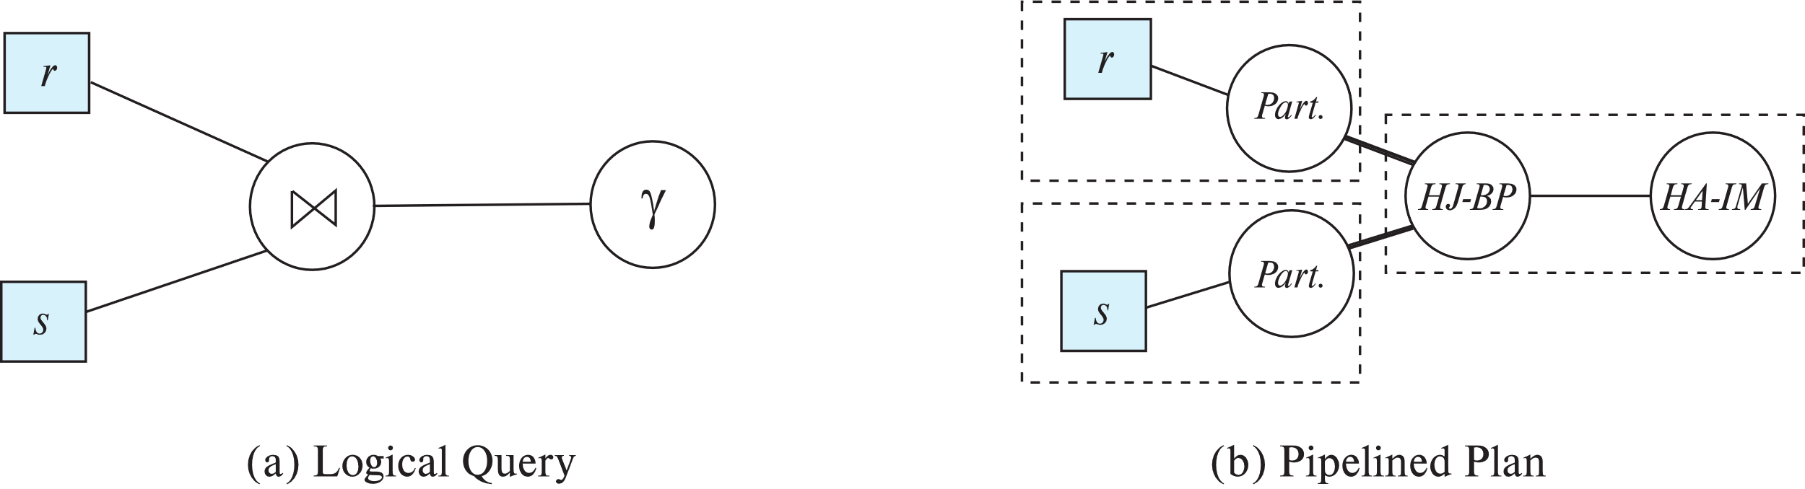
Blocking Operations
Blocking operations: cannot generate any output until all input is consumed
E.g., sorting, aggregation, …
But can often consume inputs from a pipeline, or produce outputs to a pipeline
Key idea: blocking operations often have two suboperations
E.g., for sort: run generation and merge
For hash join: partitioning and build-probe
Treat them as separate operations

Slide 107
Pipeline Stages
Pipeline stages:
All operations in a stage run concurrently
A stage can start only after preceding stages have completed execution

Slide 108
Evaluation Algorithms for Pipelining
Some algorithms are not able to output results even as they get input tuples
E.g., merge join, or hash join
intermediate results written to disk and then read back
Algorithm variants to generate (at least some) results on the fly, as input tuples are read in
E.g., hybrid hash join generates output tuples even as probe relation tuples in the in-memory partition (partition 0) are read in
Double-pipelined join technique: Hybrid hash join, modified to buffer partition 0 tuples of both relations in-memory, reading them as they become available, and output results of any matches between partition 0 tuples
When a new r₀ tuple is found, match it with existing s₀ tuples, output matches, and save it in r₀
Symmetrically for s₀ tuples

Slide 109
Pipelining for Continuous-Stream Data
Data streams
Data entering database in a continuous manner
E.g., Sensor networks, user clicks, …
Continuous queries
Results get updated as streaming data enters the database
Aggregation on windows is often used
E.g., tumbling windows divide time into units, e.g., hours, minutes
Need to use pipelined processing algorithms
Punctuations used to infer when all data for a window has been received

Slide 110
Query Processing in Memory
Query compilation to machine code
Overheads of interpretation
E.g., repeatedly finding attribute location within tuple, from metadata
Overhead of expression evaluation
Compilation can avoid many such overheads and speed up query processing
Often via generation of Java byte code / LLVM, with just-in-time (JIT) compilation
Column-oriented storage
Allows vector operations (in conjunction with compilation)
Cache conscious algorithms

Slide 111
Cache Conscious Algorithms
Goal: minimize cache misses, make best use of data fetched into the cache as part of a cache line
For sorting:
Use runs that are as large as L3 cache (a few megabytes) to avoid cache misses during sorting of a run
Then merge runs as usual in merge-sort
For hash-join
First create partitions such that build+probe partitions fit in memory
Then subpartition further s.t. build subpartition+index fits in L3 cache
Speeds up probe phase significantly by avoiding cache misses
Lay out attributes of tuples to maximize cache usage
Attributes that are often accessed together should be stored adjacent to each other
Use multiple threads for parallel query processing
Cache misses leads to stall of one thread, but others can proceed

Slide 112
End of Chapter 15

Slide 113
Chapter 16 From the Book
Completing Disks, I/O, Indexes
113 | Introduction to Databases (F20): Lecture 9: Transactions, Query Processing, NoSQL

Slide 114
Outline
Introduction
Transformation of Relational Expressions
Catalog Information for Cost Estimation
Statistical Information for Cost Estimation
Cost-based optimization
Dynamic Programming for Choosing Evaluation Plans
Materialized views

Slide 115
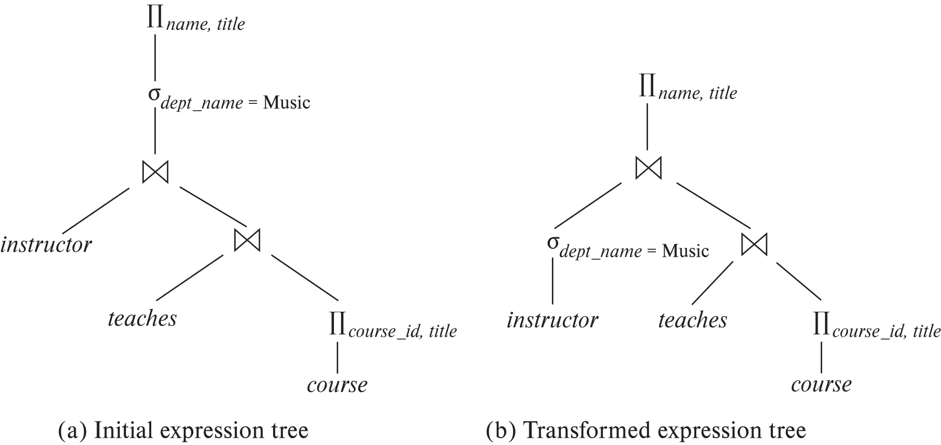
Introduction
Alternative ways of evaluating a given query
Equivalent expressions
Different algorithms for each operation

Slide 116
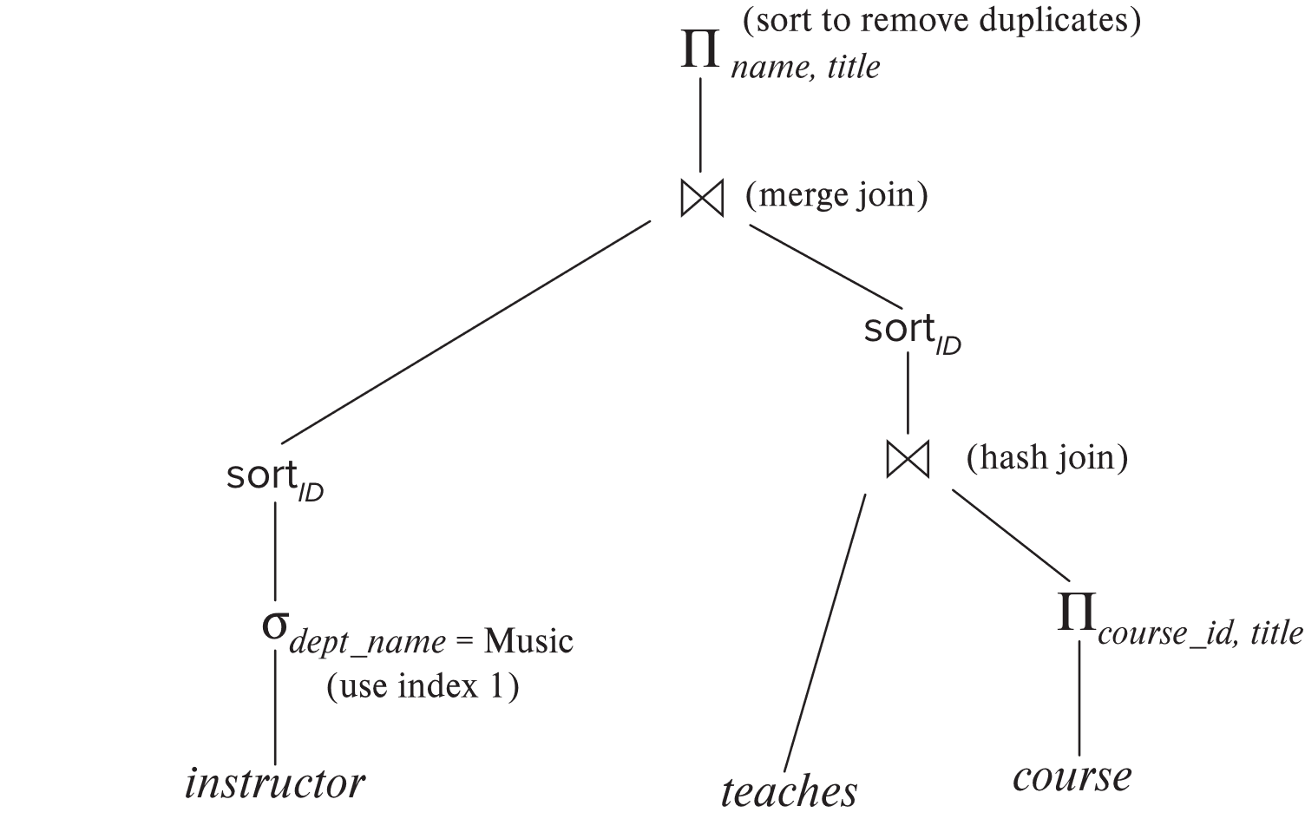
Introduction (Cont.)
An evaluation plan defines exactly what algorithm is used for each operation, and how the execution of the operations is coordinated.
Find out how to view query execution plans on your favorite database

Slide 117
Introduction (Cont.)
Cost difference between evaluation plans for a query can be enormous
E.g., seconds vs. days in some cases
Steps in cost-based query optimization
1. Generate logically equivalent expressions using equivalence rules
2. Annotate resultant expressions to get alternative query plans
3. Choose the cheapest plan based on estimated cost
Estimation of plan cost based on:
Statistical information about relations. Examples:
number of tuples, number of distinct values for an attribute
Statistics estimation for intermediate results
to compute cost of complex expressions
Cost formulae for algorithms, computed using statistics

Slide 118
Viewing Query Evaluation Plans
Most database support explain <query>
Displays plan chosen by query optimizer, along with cost estimates
Some syntax variations between databases
Oracle: explain plan for <query> followed by select * from table (dbms_xplan.display)
SQL Server: set showplan_text on
Some databases (e.g. PostgreSQL) support explain analyse <query>
Shows actual runtime statistics found by running the query, in addition to showing the plan
Some databases (e.g. PostgreSQL) show cost as f..l
f is the cost of delivering first tuple and l is cost of delivering all results

Slide 119
Generating Equivalent Expressions

Slide 120
Transformation of Relational Expressions
Two relational algebra expressions are said to be equivalent if the two expressions generate the same set of tuples on every legal database instance
Note: order of tuples is irrelevant
we don’t care if they generate different results on databases that violate integrity constraints
In SQL, inputs and outputs are multisets of tuples
Two expressions in the multiset version of the relational algebra are said to be equivalent if the two expressions generate the same multiset of tuples on every legal database instance.
An equivalence rule says that expressions of two forms are equivalent
Can replace expression of first form by second, or vice versa

Slide 121
Equivalence Rules
1. Conjunctive selection operations can be deconstructed into a sequence of individual selections. σ_{θ1 ∧ θ2} (E) ≡ σ_{θ1} (σ_{θ2} (E))
2. Selection operations are commutative. σ_{θ1}(σ_{θ2}(E)) ≡ σ_{θ2} (σ_{θ1}(E))
3. Only the last in a sequence of projection operations is needed, the others can be omitted. ∏ _{L1}(∏ _{L2}(…(∏ _{Ln}(E))…)) ≡ ∏ _{L1}(E) where L₁ ⊆ L₂ … ⊆ L_{n}
4. Selections can be combined with Cartesian products and theta joins.
σ_{θ} (E₁ x E₂) ≡ E₁ ⨝ _{θ} E₂
σ _{θ1} (E₁ ⨝_{θ2} E₂) ≡ E₁ ⨝ _{θ1∧θ2} E₂

Slide 122
Equivalence Rules (Cont.)
5. Theta-join operations (and natural joins) are commutative. E₁ ⨝ E₂ ≡ E₂ ⨝ E₁
6. (a) Natural join operations are associative:
(E₁ ⨝ E₂) ⨝ E₃ ≡ E₁ ⨝ (E₂ ⨝ E₃) (b) Theta joins are associative in the following manner: (E₁ ⨝ _{θ1} E₂) ⨝ _{θ2 ∧ θ3} E₃ ≡ E₁ ⨝_{θ1 ∧ θ3} (E₂ ⨝ _{θ2} E₃) where θ₂ involves attributes from only E₂ and E₃.

Slide 123
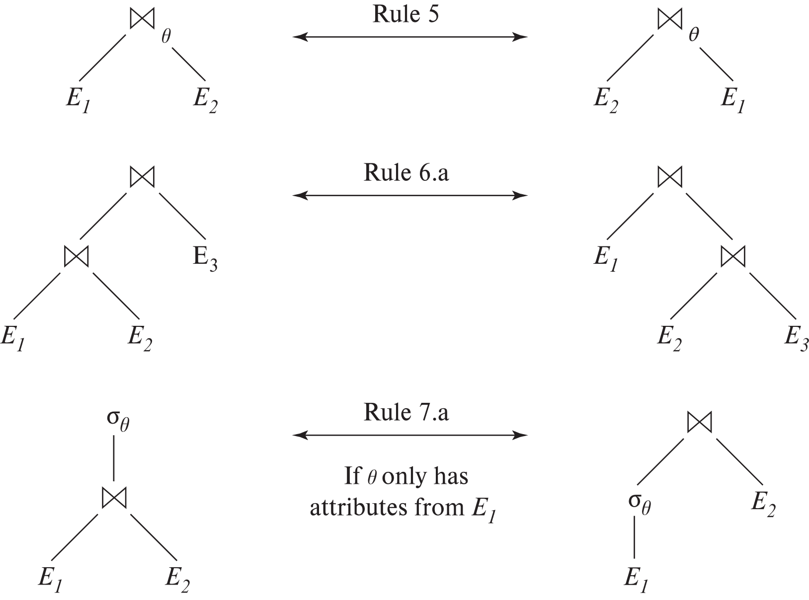
Pictorial Depiction of Equivalence Rules

Slide 124
Equivalence Rules (Cont.)
7. The selection operation distributes over the theta join operation under the following two conditions: (a) When all the attributes in θ₀ involve only the attributes of one of the expressions (E₁) being joined. σ_{θ0} (E₁ ⨝_{θ} E₂) ≡ (σ_{θ0}(E₁)) ⨝_{θ} E₂
(b) When θ₁ involves only the attributes of E₁ and θ₂ involves only the attributes of E₂.
σ_{θ1 ∧ θ2} (E₁ ⨝_{θ} E₂) ≡ (σ_{θ1}(E₁)) ⨝_{θ} (σ_{θ2}(E₂))

Slide 125
Equivalence Rules (Cont.)
8. The projection operation distributes over the theta join operation as follows:
(a) if θ involves only attributes from L₁ ∪ L₂: ∏ _{L1 ∪ L2}(E₁ ⨝_{θ} E₂) ≡ ∏ _{L1}(E₁) ⨝_{θ} ∏ _{L2}(E₂)
(b) In general, consider a join E₁ ⨝_{θ} E₂.
Let L₁ and L₂ be sets of attributes from E₁ and E₂, respectively.
Let L₃ be attributes of E₁ that are involved in join condition θ, but are not in L₁ ∪ L₂, and
let L₄ be attributes of E₂ that are involved in join condition θ, but are not in L₁ ∪ L₂. ∏ _{L1 ∪ L2}(E₁ ⨝_{θ} E₂) ≡ ∏ _{L1 ∪ L2}(∏ _{L1 ∪ L3}(E₁) ⨝_{θ} ∏ _{L2 ∪ L4}(E₂))
Similar equivalences hold for outerjoin operations: ⟕, ⟖, and ⟗

Slide 126
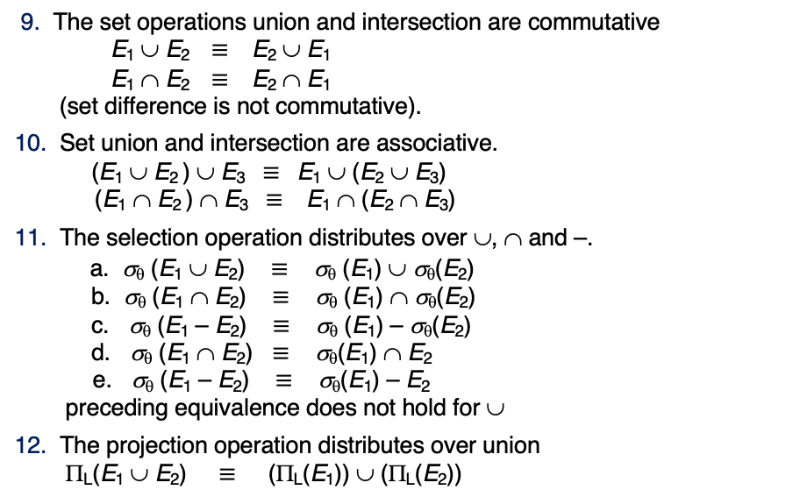
Equivalence Rules (Cont.)
9. The set operations union and intersection are commutative E₁ ∪ E₂ ≡ E₂ ∪ E₁ E₁ ∩ E₂ ≡ E₂ ∩ E₁ (set difference is not commutative).
10. Set union and intersection are associative. (E₁ ∪ E₂ ) ∪ E₃ ≡ E₁ ∪ (E₂ ∪ E₃) (E₁ ∩ E₂ ) ∩ E₃ ≡ E₁ ∩ (E₂ ∩ E₃)
11. The selection operation distributes over ∪, ∩ and –. a. σ_{θ} (E₁ ∪ E₂) ≡ σ_{θ} (E₁) ∪ σ_{θ}(E₂) b. σ_{θ} (E₁ ∩ E₂) ≡ σ_{θ} (E₁) ∩ σ_{θ}(E₂) c. σ_{θ} (E₁ – E₂) ≡ σ_{θ} (E₁) – σ_{θ}(E₂) d. σ_{θ} (E₁ ∩ E₂) ≡ σ_{θ}(E₁) ∩ E₂ e. σ_{θ} (E₁ – E₂) ≡ σ_{θ}(E₁) – E₂ preceding equivalence does not hold for ∪
12. The projection operation distributes over union Π_{L}(E₁ ∪ E₂) ≡ (Π_{L}(E₁)) ∪ (Π_{L}(E₂))

Slide 127
Exercise
Create equivalence rules involving
The group by/aggregation operation
Left outer join operation

Slide 128
Equivalence Rules (Cont.)
13. Selection distributes over aggregation as below σ_{θ}(_{G}𝛾_{A}(E)) ≡ _{G}𝛾_{A}(σ_{θ}(E)) provided θ only involves attributes in G
14. a. Full outerjoin is commutative: E₁ ⟗ E₂ ≡ E₂ ⟗ E₁ b. Left and right outerjoin are not commutative, but: E₁ ⟕ E₂ ≡ E₂ ⟖ E₁
15. Selection distributes over left and right outerjoins as below, provided θ₁
only involves attributes of E₁ a. σ_{θ1} (E₁ ⟕_{θ} E₂) ≡ (σ_{θ1} (E₁)) ⟕_{θ} E₂ b. σ_{θ1} (E₁ ⟖_{θ} E₂) ≡ E₂ ⟕_{θ} (σ_{θ1} (E₁))
16. Outerjoins can be replaced by inner joins under some conditions
a. σ_{θ1} (E₁ ⟕_{θ} E₂) ≡ σ_{θ1} (E₁ ⨝_{θ} E₂) b. σ_{θ1} (E₁ ⟖_{θ} E₁) ≡ σ_{θ1} (E₁ ⨝_{θ} E₂) provided θ₁ is null rejecting on E₂

Slide 129
Equivalence Rules (Cont.)
Note that several equivalences that hold for joins do not hold for outerjoins
σ_{year=2017}(instructor ⟕ teaches) ≢ σ_{year=2017}(instructor ⨝ teaches)
Outerjoins are not associative (r ⟕ s) ⟕ t ≢ r ⟕ (s ⟕ t)
e.g. with r(A,B) = {(1,1), s(B,C) = { (1,1)}, t(A,C) = { }
Notes:
How about (r ⟕ s) ⟕ t vs (r ⟕ t) ⟕ s assuming r has common attributes with s and t? Hint: consider 2 cases where s and t have common attributes and those where they have no common attribute

Slide 130
Transformation Example: Pushing Selections
Query: Find the names of all instructors in the Music department, along with the titles of the courses that they teach
Π_{name, title}(σ_{dept_name= ‘Music’} (instructor ⨝ (teaches ⨝ Π_{course_id, title} (course))))
Transformation using rule 7a.
Π_{name, title}((σ_{dept_name= ‘Music’}(instructor)) ⨝ (teaches ⨝ Π_{course_id, title} (course)))
Performing the selection as early as possible reduces the size of the relation to be joined.

Slide 131
Example with Multiple Transformations
Query: Find the names of all instructors in the Music department who have taught a course in 2017, along with the titles of the courses that they taught
Π_{name, title}(σ_{dept_name= "Music”∧year = 2017} (instructor ⨝ (teaches ⨝ Π_{course_id, title} (course))))
Transformation using join associatively (Rule 6a):
Π_{name, title}(σ_{dept_name= “Music”∧year = 2017} ((instructor ⨝ teaches) ⨝ Π_{course_id, title} (course)))
Second form provides an opportunity to apply the “perform selections early” rule, resulting in the subexpression
σ_{dept_name = “Music”} (instructor) ⨝ σ _{year = 2017} (teaches)

Slide 132
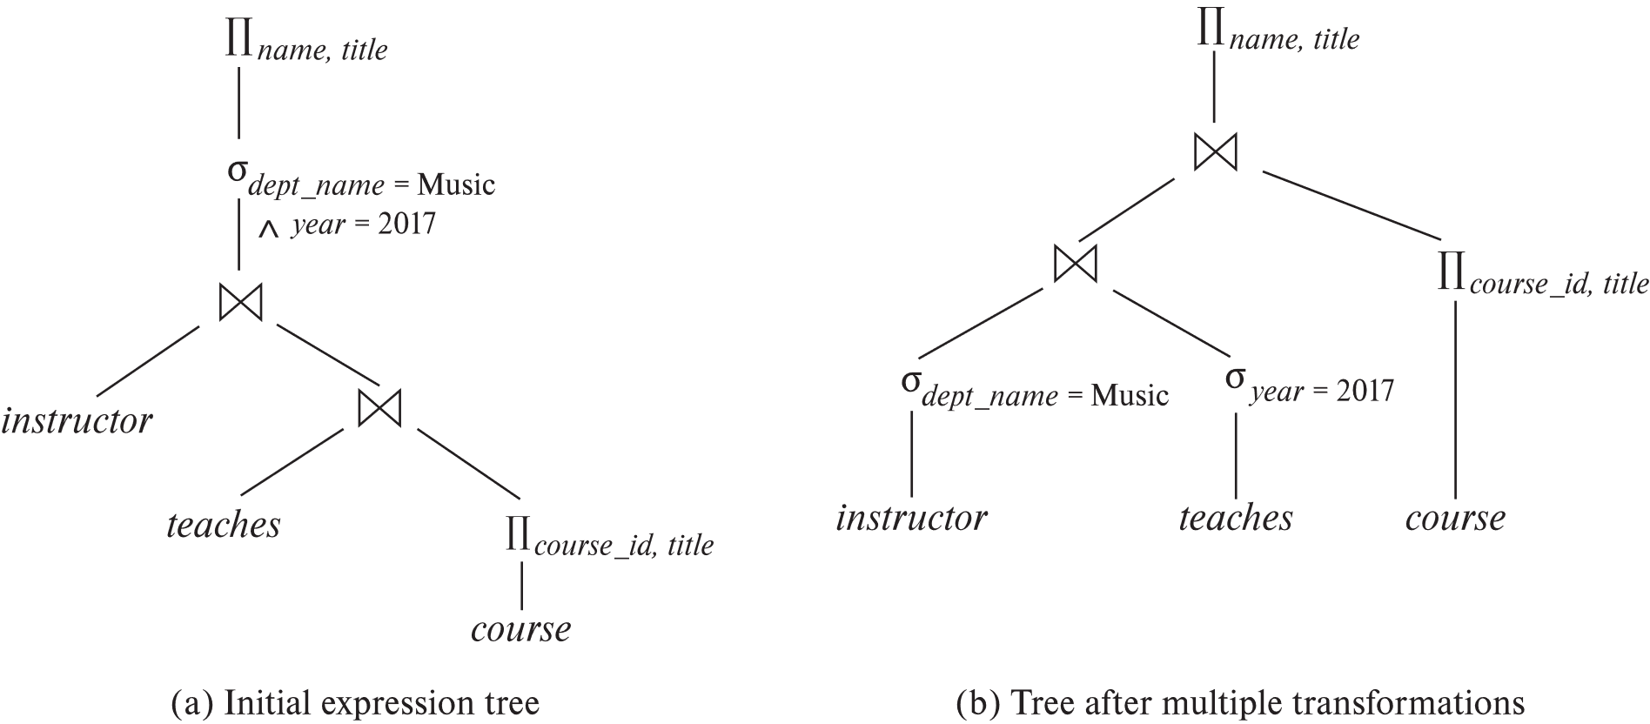
Multiple Transformations (Cont.)

Slide 133
Transformation Example: Pushing Projections
Consider: Π_{name, title}(σ_{dept_name= “Music”} (instructor) ⨝ teaches) ⨝ Π_{course_id, title} (course))))
When we compute
(σ_{dept_name = “Music”} (instructor ⨝ teaches)
we obtain a relation whose schema is: (ID, name, dept_name, salary, course_id, sec_id, semester, year)
Push projections using equivalence rules 8a and 8b; eliminate unneeded attributes from intermediate results to get: Π_{name, title}(Π_{name, course_id} ( σ_{dept_name= “Music”} (instructor) ⨝ teaches)) ⨝ Π_{course_id, title} (course))))
Performing the projection as early as possible reduces the size of the relation to be joined.

Slide 134
Join Ordering Example
For all relations r_{1,} r_{2,} and r₃,
(r₁ ⨝ r₂) ⨝ r₃ = r₁ ⨝ (r₂ ⨝ r₃ )
(Join Associativity) ⨝
If r₂ ⨝ r₃ is quite large and r₁ ⨝ r₂ is small, we choose
(r₁ ⨝ r₂) ⨝ r₃
so that we compute and store a smaller temporary relation.

Slide 135
Join Ordering Example (Cont.)
Consider the expression
Π_{name, title}(σ_{dept_name= “Music”} (instructor) ⨝ teaches) ⨝ Π_{course_id, title} (course))))
Could compute teaches ⨝ Π_{course_id, title} (course) first, and join result with σ_{dept_name= “Music”} (instructor) but the result of the first join is likely to be a large relation.
Only a small fraction of the university’s instructors are likely to be from the Music department
it is better to compute
σ_{dept_name= “Music”} (instructor) ⨝ teaches
first.

Slide 136
Enumeration of Equivalent Expressions
Query optimizers use equivalence rules to systematically generate expressions equivalent to the given expression
Can generate all equivalent expressions as follows:
Repeat
apply all applicable equivalence rules on every subexpression of every equivalent expression found so far
add newly generated expressions to the set of equivalent expressions
Until no new equivalent expressions are generated above
The above approach is very expensive in space and time
Two approaches
Optimized plan generation based on transformation rules
Special case approach for queries with only selections, projections and joins

Slide 137
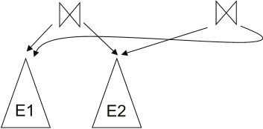
Implementing Transformation Based Optimization
Space requirements reduced by sharing common sub-expressions:
when E1 is generated from E2 by an equivalence rule, usually only the top level of the two are different, subtrees below are the same and can be shared using pointers
E.g., when applying join commutativity
Same sub-expression may get generated multiple times
Detect duplicate sub-expressions and share one copy
Time requirements are reduced by not generating all expressions
Dynamic programming
We will study only the special case of dynamic programming for join order optimization

Slide 138
Cost Estimation
Cost of each operator computer as described in Chapter 15
Need statistics of input relations
E.g., number of tuples, sizes of tuples
Inputs can be results of sub-expressions
Need to estimate statistics of expression results
To do so, we require additional statistics
E.g., number of distinct values for an attribute
More on cost estimation later

Slide 139
Choice of Evaluation Plans
Must consider the interaction of evaluation techniques when choosing evaluation plans
choosing the cheapest algorithm for each operation independently may not yield best overall algorithm. E.g.
merge-join may be costlier than hash-join, but may provide a sorted output which reduces the cost for an outer level aggregation.
nested-loop join may provide opportunity for pipelining
Practical query optimizers incorporate elements of the following two broad approaches:
1. Search all the plans and choose the best plan in a cost-based fashion.
2. Uses heuristics to choose a plan.

Slide 140
Cost-Based Optimization
Consider finding the best join-order for r₁ ⨝ r₂ ⨝ . . . ⨝ r_{n}.
There are (2(n – 1))!/(n – 1)! different join orders for above expression. With n = 7, the number is 665280, with n = 10, the number is greater than 176 billion!
No need to generate all the join orders. Using dynamic programming, the least-cost join order for any subset of {r₁, r₂, . . . r_{n}} is computed only once and stored for future use.

Slide 141
Dynamic Programming in Optimization
To find best join tree for a set of n relations:
To find best plan for a set S of n relations, consider all possible plans of the form: S₁ ⨝ (S – S₁) where S₁ is any non-empty subset of S.
Recursively compute costs for joining subsets of S to find the cost of each plan. Choose the cheapest of the 2^{n} – 2 alternatives.
Base case for recursion: single relation access plan
Apply all selections on R_{i} using best choice of indices on R_{i}
When plan for any subset is computed, store it and reuse it when it is required again, instead of recomputing it
Dynamic programming

Slide 142
Join Order Optimization Algorithm
procedure findbestplan(S) if (bestplan[S].cost ≠ ∞) return bestplan[S] // else bestplan[S] has not been computed earlier, compute it now if (S contains only 1 relation) set bestplan[S].plan and bestplan[S].cost based on the best way of accessing S using selections on S and indices (if any) on S else for each non-empty subset S1 of S such that S1 ≠ S P1= findbestplan(S1) P2= findbestplan(S - S1) for each algorithm A for joining results of P1 and P2 … compute plan and cost of using A (see next page) .. if cost < bestplan[S].cost bestplan[S].cost = cost bestplan[S].plan = plan; return bestplan[S]

Slide 143
Join Order Optimization Algorithm (cont.)
for each algorithm A for joining results of P1 and P2 // For indexed-nested loops join, the outer could be P1 or P2 // Similarly for hash-join, the build relation could be P1 or P2 // We assume the alternatives are considered as separate algorithms
if algorithm A is indexed nested loops Let P_{i} and P_{o} denote inner and outer inputs if P_{i} has a single relation r_{i} and r_{i} has an index on the join attribute
plan = “execute P_{o}.plan; join results of P_{o} and r_{i} using A”, with any selection conditions on P_{i} performed as part of the join condition cost = P_{o}.cost + cost of A else cost = ∞; /* cannot use indexed nested loops join */ else plan = “execute P1.plan; execute P2.plan; join results of P1 and P2 using A;” cost = P1.cost + P2.cost + cost of A
…. See previous page

Slide 144
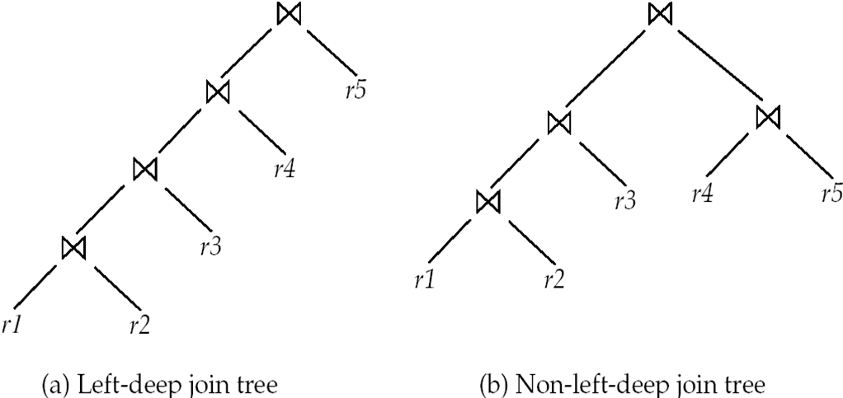
Left Deep Join Trees
In left-deep join trees, the right-hand-side input for each join is a relation, not the result of an intermediate join.

Slide 145
Cost of Optimization
With dynamic programming time complexity of optimization with bushy trees is O(3^{n}).
With n = 10, this number is 59000 instead of 176 billion!
Space complexity is O(2^{n})
To find best left-deep join tree for a set of n relations:
Consider n alternatives with one relation as right-hand side input and the other relations as left-hand side input.
Modify optimization algorithm:
Replace “for each non-empty subset S1 of S such that S1 ≠ S”
By: for each relation r in S let S1 = S – r .
If only left-deep trees are considered, time complexity of finding best join order is O(n 2^{n})
Space complexity remains at O(2^{n})
Cost-based optimization is expensive, but worthwhile for queries on large datasets (typical queries have small n, generally < 10)

Slide 146
Interesting Sort Orders
Consider the expression (r₁ ⨝ r₂) ⨝ r₃ (with A as common attribute)
An interesting sort order is a particular sort order of tuples that could make a later operation (join/group by/order by) cheaper
Using merge-join to compute r₁ ⨝ r₂ may be costlier than hash join but generates result sorted on A
Which in turn may make merge-join with r₃ cheaper, which may reduce cost of join with r₃ and minimizing overall cost
Not sufficient to find the best join order for each subset of the set of n given relations
must find the best join order for each subset, for each interesting sort order
Simple extension of earlier dynamic programming algorithms
Usually, number of interesting orders is quite small and doesn’t affect time/space complexity significantly

Slide 147
Cost Based Optimization with Equivalence Rules
Physical equivalence rules allow logical query plan to be converted to physical query plan specifying what algorithms are used for each operation.
Efficient optimizer based on equivalent rules depends on
A space efficient representation of expressions which avoids making multiple copies of subexpressions
Efficient techniques for detecting duplicate derivations of expressions
A form of dynamic programming based on memoization, which stores the best plan for a subexpression the first time it is optimized, and reuses in on repeated optimization calls on same subexpression
Cost-based pruning techniques that avoid generating all plans
Pioneered by the Volcano project and implemented in the SQL Server optimizer

Slide 148
Heuristic Optimization
Cost-based optimization is expensive, even with dynamic programming.
Systems may use heuristics to reduce the number of choices that must be made in a cost-based fashion.
Heuristic optimization transforms the query-tree by using a set of rules that typically (but not in all cases) improve execution performance:
Perform selection early (reduces the number of tuples)
Perform projection early (reduces the number of attributes)
Perform most restrictive selection and join operations (i.e., with smallest result size) before other similar operations.
Some systems use only heuristics, others combine heuristics with partial cost-based optimization.

Slide 149
Structure of Query Optimizers
Many optimizers considers only left-deep join orders.
Plus heuristics to push selections and projections down the query tree
Reduces optimization complexity and generates plans amenable to pipelined evaluation.
Heuristic optimization used in some versions of Oracle:
Repeatedly pick “best” relation to join next
Starting from each of n starting points. Pick best among these
Intricacies of SQL complicate query optimization
E.g., nested subqueries

Slide 150
Structure of Query Optimizers (Cont.)
Some query optimizers integrate heuristic selection and the generation of alternative access plans.
Frequently used approach
heuristic rewriting of nested block structure and aggregation
followed by cost-based join-order optimization for each block
Some optimizers (e.g. SQL Server) apply transformations to entire query and do not depend on block structure
Optimization cost budget to stop optimization early (if cost of plan is less than cost of optimization)
Plan caching to reuse previously computed plan if query is resubmitted
Even with different constants in query
Even with the use of heuristics, cost-based query optimization imposes a substantial overhead.
But is worth it for expensive queries
Optimizers often use simple heuristics for very cheap queries, and perform exhaustive enumeration for more expensive queries

Slide 151
Statistics for Cost Estimation

Slide 152
Statistical Information for Cost Estimation
n_{r}: number of tuples in a relation r.
b_{r}: number of blocks containing tuples of r.
l_{r}: size of a tuple of r.
f_{r}: blocking factor of r — i.e., the number of tuples of r that fit into one block.
V(A, r): number of distinct values that appear in r for attribute A; same as the size of ∏_{A}(r).
If tuples of r are stored together physically in a file, then:
R JOIN L, L JOIN R
Smallest table on the right.

Slide 153
Histograms
Histogram on attribute age of relation person
Equi-width histograms
Equi-depth histograms break up range such that each range has (approximately) the same number of tuples
E.g. (4, 8, 14, 19)
Many databases also store n most-frequent values and their counts
Histogram is built on remaining values only

Slide 154
Histograms (cont.)
Histograms and other statistics usually computed based on a random sample
Statistics may be out of date
Some database require a analyze command to be executed to update statistics
Others automatically recompute statistics
e.g., when number of tuples in a relation changes by some percentage

Slide 155
Selection Size Estimation
σ_{A=v}(r)
n_{r} / V(A,r) : number of records that will satisfy the selection
Equality condition on a key attribute: size estimate = 1
σ_{A≤V}(r) (case of σ_{A ≥ V}(r) is symmetric)
Let c denote the estimated number of tuples satisfying the condition.
If min(A,r) and max(A,r) are available in catalog
c = 0 if v < min(A,r)
c =
If histograms available, can refine above estimate
In absence of statistical information c is assumed to be n_{r} / 2.

Slide 156
Size Estimation of Complex Selections
The selectivity of a condition θ_{i} is the probability that a tuple in the relation r satisfies θ_{i} .
If s_{i} is the number of satisfying tuples in r, the selectivity of θ_{i} is given by s_{i} /n_{r}.
Conjunction: σ_{θ1∧ θ2∧. . . ∧ θn} (r). Assuming independence, estimate of tuples in the result is:
Disjunction:σ_{θ1∨} _{θ2 ∨. . . ∨} _{θn} (r). Estimated number of tuples:
Negation: σ_{¬θ}(r). Estimated number of tuples: n_{r} – size(σ_{θ}(r))

Slide 157
Join Operation: Running Example
Running example: student ⨝ takes
Catalog information for join examples:
n_{student} = 5,000.
f_{student} = 50, which implies that b_{student} =5000/50 = 100.
n_{takes} = 10000.
f_{takes} = 25, which implies that b_{takes} = 10000/25 = 400.
V(ID, takes) = 2500, which implies that on average, each student who has taken a course has taken 4 courses.
Attribute ID in takes is a foreign key referencing student.
V(ID, student) = 5000 (primary key!)

Slide 158
Estimation of the Size of Joins
The Cartesian product r x s contains n_{r} .n_{s} tuples; each tuple occupies s_{r} + s_{s} bytes.
If R ∩ S = ∅, then r ⋈ s is the same as r x s.
If R ∩ S is a key for R, then a tuple of s will join with at most one tuple from r
therefore, the number of tuples in r ⋈ s is no greater than the number of tuples in s.
If R ∩ S in S is a foreign key in S referencing R, then the number of tuples in r ⋈ s is exactly the same as the number of tuples in s.
The case for R ∩ S being a foreign key referencing S is symmetric.
In the example query student ⋈ takes, ID in takes is a foreign key referencing student
hence, the result has exactly n_{takes} tuples, which is 10000

Slide 159
Estimation of the Size of Joins (Cont.)
If R ∩ S = {A} is not a key for R or S. If we assume that every tuple t in R produces tuples in R S, the number of tuples in R ⨝ S is estimated to be: If the reverse is true, the estimate obtained will be: The lower of these two estimates is probably the more accurate one.
Can improve on above if histograms are available
Use formula similar to above, for each cell of histograms on the two relations

Slide 160
Estimation of the Size of Joins (Cont.)
Compute the size estimates for depositor ⨝ customer without using information about foreign keys:
V(ID, takes) = 2500, and V(ID, student) = 5000
The two estimates are 5000 * 10000/2500 = 20,000 and 5000 * 10000/5000 = 10000
We choose the lower estimate, which in this case, is the same as our earlier computation using foreign keys.

Slide 161
Size Estimation for Other Operations
Projection: estimated size of ∏_{A}(r) = V(A,r)
Aggregation : estimated size of _{G}𝛾_{A}(r) = V(G,r)
Set operations
For unions/intersections of selections on the same relation: rewrite and use size estimate for selections
E.g., σ_{θ1} (r) ∪ σ_{θ2} (r) can be rewritten as σ_{θ1 or θ2} (r)
For operations on different relations:
estimated size of r ∪ s = size of r + size of s.
estimated size of r ∩ s = minimum size of r and size of s.
estimated size of r – s = r.
All the three estimates may be quite inaccurate, but provide upper bounds on the sizes.

Slide 162
Size Estimation (Cont.)
Outer join:
Estimated size of r ⟕ s = size of r ⨝ s + size of r
Case of right outer join is symmetric
Estimated size of r ⟗ s = size of r ⨝ s + size of r + size of s

Slide 163
Estimation of Number of Distinct Values
Selections: σ_{θ} (r)
If θ forces A to take a specified value: V(A,σ_{θ} (r)) = 1.
e.g., A = 3
If θ forces A to take on one of a specified set of values: V(A,σ_{θ} (r)) = number of specified values.
(e.g., (A = 1 V A = 3 V A = 4 )),
If the selection condition θ is of the form A op r estimated V(A,σ_{θ} (r)) = V(A.r) * s
where s is the selectivity of the selection.
In all the other cases: use approximate estimate of min(V(A,r), n_{σθ (r)} )
More accurate estimate can be got using probability theory, but this one works fine generally

Slide 164
Estimation of Distinct Values (Cont.)
Joins: r ⨝ s
If all attributes in A are from r estimated V(A, r ⨝ s) = min (V(A,r), n _{r ⨝ s})
If A contains attributes A1 from r and A2 from s, then estimated V(A,r ⨝ s) =
min(V(A1,r)*V(A2 – A1,s), V(A1 – A2,r)*V(A2,s), n_{r ⨝ s})
More accurate estimate can be got using probability theory, but this one works fine generally

Slide 165
Estimation of Distinct Values (Cont.)
Estimation of distinct values are straightforward for projections.
They are the same in ∏_{A (r)} as in r.
The same holds for grouping attributes of aggregation.
For aggregated values
For min(A) and max(A), the number of distinct values can be estimated as min(V(A,r), V(G,r)) where G denotes grouping attributes
For other aggregates, assume all values are distinct, and use V(G,r)

Slide 166
Additional Optimization techniques

Slide 167
Optimizing Nested Subqueries**
Nested query example: select name from instructor where exists (select * from teaches where instructor.ID = teaches.ID and teaches.year = 2019)
SQL conceptually treats nested subqueries in the where clause as functions that take parameters and return a single value or set of values
Parameters are variables from outer level query that are used in the nested subquery; such variables are called correlation variables
Conceptually, nested subquery is executed once for each tuple in the cross-product generated by the outer level from clause
Such evaluation is called correlated evaluation
Note: other conditions in where clause may be used to compute a join (instead of a cross-product) before executing the nested subquery

Slide 168
Optimizing Nested Subqueries (Cont.)
Correlated evaluation may be quite inefficient since
a large number of calls may be made to the nested query
there may be unnecessary random I/O as a result
SQL optimizers attempt to transform nested subqueries to joins where possible, enabling use of efficient join techniques
E.g.,: earlier nested query can be rewritten as ∏ _{name}(instructor ⨝instructor.ID=teaches.ID ∧ teaches.year=2019 teaches)
Note: the two queries generate different numbers of duplicates (why?)
Can be modified to handle duplicates correctly using semijoins

Slide 169
Optimizing Nested Subqueries (Cont.)
The semijoin operator ⋉ is defined as follows
A tuple r_{i} appears n times in r ⋉ _{θ} s if it appears n times in r, and there is at least one matching tuple s_{i} in s
E.g.: earlier nested query can be rewritten as ∏ _{name}(instructor ⋉ instructor.ID=teaches.ID ∧ teaches.year=2019 teaches)
Or even as: ∏_{name}(instructor ⋉_{instructor.ID=teaches.ID} (σ_{teaches.year=2019} teaches))
Now the duplicate count is correct!
The above relational algebra query is also equivalent to from instructor where ID in (select teaches.ID from teaches where teaches.year = 2019)

Slide 170
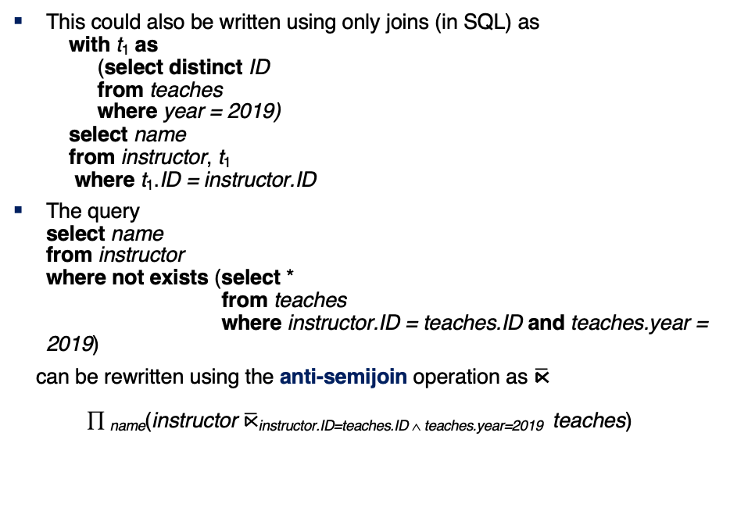
Optimizing Nested Subqueries (Cont.)
This could also be written using only joins (in SQL) as with t₁ as (select distinct ID from teaches where year = 2019) select name from instructor, t₁ where t₁.ID = instructor.ID
The query select name from instructor where not exists (select * from teaches where instructor.ID = teaches.ID and teaches.year = 2019)
can be rewritten using the anti-semijoin operation as $\overline{\text{⋉}}$ ∏ _{name}(instructor $\overline{\text{⋉}}$instructor.ID=teaches.ID ∧ teaches.year=2019 teaches)

Slide 171
Optimizing Nested Subqueries (Cont.)
In general, SQL queries of the form below can be rewritten as shown
Rewrite: select A from r₁, r₂ ,…, r_{n} where P₁ and exists (select * from s₁, s₂ ,…, s_{m} where P₂¹ and P₂² )
To: ∏ _{A}(σ _{P1} (r₁ x r₂ x … x r_{n} ) ⋉ _{P22} σ _{P21} (s₁ x s₂ x … x s_{m} )
P₂¹ contains predicates that do not involve any correlation variables
P₂² contains predicates involving correlation variables
The process of replacing a nested query by a query with a join/semijoin (possibly with a temporary relation) is called decorrelation.
Decorrelation is more complicated in several cases, e.g.
The nested subquery uses aggregation, or
The nested subquery is a scalar subquery
Correlated evaluation used in these cases

Slide 172
Decorrelation (Cont.)
Decorrelation of scalar aggregate subqueries can be done using groupby/aggregation in some cases
select name from instructor where 1 < (select count(*) from teaches where instructor.ID = teaches.ID and teaches.year = 2019)
∏ _{name}(instructor ⋉ _{instructor.ID=TID ∧ 1 < cnt} ( _{ID as TID} 𝛾_{count(*) as cnt} (σ _{teaches.year=2019} (teaches))))

Slide 173
Materialized Views
A materialized view is a view whose contents are computed and stored.
Consider the view create view department_total_salary(dept_name, total_salary) as select dept_name, sum(salary) from instructor group by dept_name
Materializing the above view would be very useful if the total salary by department is required frequently
Saves the effort of finding multiple tuples and adding up their amounts

Slide 174
Materialized View Maintenance
The task of keeping a materialized view up-to-date with the underlying data is known as materialized view maintenance
Materialized views can be maintained by recomputation on every update
A better option is to use incremental view maintenance
Changes to database relations are used to compute changes to the materialized view, which is then updated
View maintenance can be done by
Manually defining triggers on insert, delete, and update of each relation in the view definition
Manually written code to update the view whenever database relations are updated
Periodic recomputation (e.g. nightly)
Incremental maintenance supported by many database systems
Avoids manual effort/correctness issues

Slide 175
Incremental View Maintenance
The changes (inserts and deletes) to a relation or expressions are referred to as its differential
Set of tuples inserted to and deleted from r are denoted i_{r} and d_{r}
To simplify our description, we only consider inserts and deletes
We replace updates to a tuple by deletion of the tuple followed by insertion of the update tuple
We describe how to compute the change to the result of each relational operation, given changes to its inputs
We then outline how to handle relational algebra expressions

Slide 176
Join Operation
Consider the materialized view v = r ⨝ s and an update to r
Let r^{old} and r^{new} denote the old and new states of relation r
Consider the case of an insert to r:
We can write r^{new} ⨝ s as (r^{old} ∪ i_{r}) ⨝ s
And rewrite the above to (r^{old} ⨝ s) ∪ (i_{r} ⨝ s)
But (r^{old} ⨝ s) is simply the old value of the materialized view, so the incremental change to the view is just i_{r} ⨝ s
Thus, for inserts v^{new} = v^{old} ∪(i_{r} ⨝ s)
Similarly for deletes v^{new} = v^{old} – (d_{r} ⨝ s)
A, 1
B, 2
1, p
2, r
2, s
A, 1, p
B, 2, r
B, 2, s
C,2
C, 2, r
C, 2, s

Slide 177
Selection and Projection Operations
Selection: Consider a view v = σ_{θ}(r).
v^{new} = v^{old} ∪σ_{θ}(i_{r})
v^{new} = v^{old} - σ_{θ}(d_{r})
Projection is a more difficult operation
R = (A,B), and r(R) = { (a,2), (a,3)}
∏_{A}(r) has a single tuple (a).
If we delete the tuple (a,2) from r, we should not delete the tuple (a) from ∏_{A}(r), but if we then delete (a,3) as well, we should delete the tuple
For each tuple in a projection ∏_{A}(r) , we will keep a count of how many times it was derived
On insert of a tuple to r, if the resultant tuple is already in ∏_{A}(r) we increment its count, else we add a new tuple with count = 1
On delete of a tuple from r, we decrement the count of the corresponding tuple in ∏_{A}(r)
if the count becomes 0, we delete the tuple from ∏_{A}(r)

Slide 178
Aggregation Operations
Count : v = _{A} 𝛾 _{count(B)}^{(r)}.
When a set of tuples i_{r} is inserted
For each tuple r in i_{r}, if the corresponding group is already present in v, we increment its count, else we add a new tuple with count = 1
When a set of tuples d_{r} is deleted
for each tuple t in i_{r.}we look for the group t.A in v, and subtract 1 from the count for the group.
If the count becomes 0, we delete from v the tuple for the group t.A
Sum: v = _{A} 𝛾 _{sum (B)}^{(r)}
We maintain the sum in a manner similar to count, except we add/subtract the B value instead of adding/subtracting 1 for the count
Additionally we maintain the count in order to detect groups with no tuples. Such groups are deleted from v
Cannot simply test for sum = 0 (why?)

Slide 179
Aggregate Operations (Cont.)
Avg: How to handle average?
Maintain sum and count separately, and divide at the end
min, max: v = _{A} 𝛾 _{min (B)} (r).
Handling insertions on r is straightforward.
Maintaining the aggregate values min and max on deletions may be more expensive. We have to look at the other tuples of r that are in the same group to find the new minimum

Slide 180
Other Operations
Set intersection: v = r ∩ s
when a tuple is inserted in r we check if it is present in s, and if so we add it to v.
If the tuple is deleted from r, we delete it from the intersection if it is present.
Updates to s are symmetric
The other set operations, union and set difference are handled in a similar fashion.
Outer joins are handled in much the same way as joins but with some extra work
we leave details to you.

Slide 181
Handling Expressions
To handle an entire expression, we derive expressions for computing the incremental change to the result of each sub-expressions, starting from the smallest sub-expressions.
E.g., consider E₁ ⨝ E₂ where each of E₁ and E₂ may be a complex expression
Suppose the set of tuples to be inserted into E₁ is given by D₁
Computed earlier, since smaller sub-expressions are handled first
Then the set of tuples to be inserted into E₁ ⨝ E₂ is given by D₁ ⨝ E₂
This is just the usual way of maintaining joins

Slide 182
Query Optimization and Materialized Views
Rewriting queries to use materialized views:
A materialized view v = r ⨝ s is available
A user submits a query r ⨝ s ⨝ t
We can rewrite the query as v ⨝ t
Whether to do so depends on cost estimates for the two alternative
Replacing a use of a materialized view by the view definition:
A materialized view v = r ⨝ s is available, but without any index on it
User submits a query σ_{A=10}(v).
Suppose also that s has an index on the common attribute B, and r has an index on attribute A.
The best plan for this query may be to replace v by r ⨝ s, which can lead to the query plan σ_{A=10}(r) ⨝ s
Query optimizer should be extended to consider all above alternatives and choose the best overall plan

Slide 183
Materialized View Selection
Materialized view selection: “What is the best set of views to materialize?”
Index selection: “what is the best set of indices to create”
closely related, to materialized view selection
but simpler
Materialized view selection and index selection based on typical system workload (queries and updates)
Typical goal: minimize time to execute workload , subject to constraints on space and time taken for some critical queries/updates
One of the steps in database tuning
more on tuning in later chapters
Commercial database systems provide tools (called “tuning assistants” or “wizards”) to help the database administrator choose what indices and materialized views to create

Slide 184
Top-K Queries
Top-K queries
select * from r, s where r.B = s.B order by r.A ascending limit 10
Alternative 1: Indexed nested loops join with r as outer
Alternative 2: estimate highest r.A value in result and add selection (and r.A <= H) to where clause
If < 10 results, retry with larger H

Slide 185
Optimization of Updates
Halloween problem
update R set A = 5 * A where A > 10
If index on A is used to find tuples satisfying A > 10, and tuples updated immediately, same tuple may be found (and updated) multiple times
Solution 1: Always defer updates
collect the updates (old and new values of tuples) and update relation and indices in second pass
Drawback: extra overhead even if e.g. update is only on R.B, not on attributes in selection condition
Solution 2: Defer only if required
Perform immediate update if update does not affect attributes in where clause, and deferred updates otherwise.

Slide 186
Join Minimization
Join minimization
select r.A, r.B from r, s where r.B = s.B
Check if join with s is redundant, drop it
E.g., join condition is on foreign key from r to s, r.B is declared as not null, and no selection on s
Other sufficient conditions possible select r.A, s2.B from r, s as s1, s as s2 where r.B=s1.B and r.B = s2.B and s1.A < 20 and s2.A < 10
join with s1 is redundant and can be dropped (along with selection on s1)
Lots of research in this area since 70s/80s!

Slide 187
Multiquery Optimization
Example
Q1: select * from (r natural join t) natural join s
Q2: select * from (r natural join u) natural join s
Both queries share common subexpression (r natural join s)
May be useful to compute (r natural join s) once and use it in both queries
But this may be more expensive in some situations
e.g. (r natural join s) may be expensive, plans as shown in queries may be cheaper
Multiquery optimization: find best overall plan for a set of queries, expoiting sharing of common subexpressions between queries where it is useful

Slide 188
Multiquery Optimization (Cont.)
Simple heuristic used in some database systems:
optimize each query separately
detect and exploiting common subexpressions in the individual optimal query plans
May not always give best plan, but is cheap to implement
Shared scans: widely used special case of multiquery optimization
Set of materialized views may share common subexpressions
As a result, view maintenance plans may share subexpressions
Multiquery optimization can be useful in such situations
Notes:
188

Slide 189
Parametric Query Optimization
Example select * from r natural join s where r.a < $1
value of parameter $1 not known at compile time
known only at run time
different plans may be optimal for different values of $1
Solution 1: optimize at run time, each time query is submitted
can be expensive
Solution 2: Parametric Query Optimization:
optimizer generates a set of plans, optimal for different values of $1
Set of optimal plans usually small for 1 to 3 parameters
Key issue: how to do find set of optimal plans efficiently
best one from this set is chosen at run time when $1 is known
Solution 3: Query Plan Caching
If optimizer decides that same plan is likely to be optimal for all parameter values, it caches plan and reuses it, else reoptimize each time
Implemented in many database systems

Slide 190
Plan Stability Across Optimizer Changes
What if 95% of plans are faster on database/optimizer version N+1 than on N, but 5% are slower?
Why should plans be slower on new improved optimizer?
Answer: Two wrongs can make a right, fixing one wrong can make things worse!
Approaches:
Allow hints for tuning queries
Not practical for migrating large systems with no access to source code
Set optimization level, default to version N (Oracle)
And migrate one query at a time after testing both plans on new optimizer
Save plan from version N, and give it to optimizer version N+1
Sybase, XML representation of plans (SQL Server)

Slide 191
Adaptive Query Processing
Some systems support adaptive operators that change execution algorithm on the fly
E.g., (indexed) nested loops join or hash join chosen at run time, depending on size of outer input
Other systems allow monitoring of behavior of plan at run time and adapt plan
E.g., if statistics such as number of rows is found to be very different in reality from what optimizer estimated
Can stop execution, compute fresh plan, and restart
But must avoid too many such restarts

Slide 192
End of Chapter

Slide 193
Figure 13.01

Slide 194
Figure 13.02

Slide 195
Figure 13.03

Slide 196
Figure 13.04

Slide 197
Figure 13.06

Slide 198
Figure 13.08

Slide 199
Transactions
199 | Introduction to Databases (F18): Lecture 10 Query Processing. Transactions, Recovery

Slide 200
Module 17: Transactions

Slide 201
Outline
Transaction Concept
Transaction State
Concurrent Executions
Serializability
Recoverability
Implementation of Isolation
Transaction Definition in SQL
Testing for Serializability.

Slide 202
Transaction Concept
A transaction is a unit of program execution that accesses and possibly updates various data items.
E.g., transaction to transfer $50 from account A to account B:
1. read(A)
2. A := A – 50
3. write(A)
4. read(B)
5. B := B + 50
6. write(B)
Two main issues to deal with:
Failures of various kinds, such as hardware failures and system crashes
Concurrent execution of multiple transactions

Slide 203
Example of Fund Transfer
Transaction to transfer $50 from account A to account B:
1. read(A)
2. A := A – 50
3. write(A)
4. read(B)
5. B := B + 50
6. write(B)
Atomicity requirement
If the transaction fails after step 3 and before step 6, money will be “lost” leading to an inconsistent database state
Failure could be due to software or hardware
The system should ensure that updates of a partially executed transaction are not reflected in the database
Durability requirement — once the user has been notified that the transaction has completed (i.e., the transfer of the $50 has taken place), the updates to the database by the transaction must persist even if there are software or hardware failures.

Slide 204
Example of Fund Transfer (Cont.)
Consistency requirement in above example:
The sum of A and B is unchanged by the execution of the transaction
In general, consistency requirements include
Explicitly specified integrity constraints such as primary keys and foreign keys
Implicit integrity constraints
e.g., sum of balances of all accounts, minus sum of loan amounts must equal value of cash-in-hand
A transaction must see a consistent database.
During transaction execution the database may be temporarily inconsistent.
When the transaction completes successfully the database must be consistent
Erroneous transaction logic can lead to inconsistency

Slide 205
Example of Fund Transfer (Cont.)
Isolation requirement — if between steps 3 and 6, another transaction T2 is allowed to access the partially updated database, it will see an inconsistent database (the sum A + B will be less than it should be).
T1 T2
1. read(A)
2. A := A – 50
3. write(A) read(A), read(B), print(A+B)
4. read(B)
5. B := B + 50
6. write(B
Isolation can be ensured trivially by running transactions serially
That is, one after the other.
However, executing multiple transactions concurrently has significant benefits, as we will see later.

Slide 206
ACID Properties
A transaction is a unit of program execution that accesses and possibly updates various data items. To preserve the integrity of data the database system must ensure:
Atomicity. Either all operations of the transaction are properly reflected in the database or none are.
Consistency. Execution of a transaction in isolation preserves the consistency of the database.
Isolation. Although multiple transactions may execute concurrently, each transaction must be unaware of other concurrently executing transactions. Intermediate transaction results must be hidden from other concurrently executed transactions.
That is, for every pair of transactions T_{i} and T_{j}, it appears to T_{i} that either T_{j}, finished execution before T_{i} started, or T_{j} started execution after T_{i} finished.
Durability. After a transaction completes successfully, the changes it has made to the database persist, even if there are system failures.

Slide 207
Transaction State
Active – the initial state; the transaction stays in this state while it is executing
Partially committed – after the final statement has been executed.
Failed -- after the discovery that normal execution can no longer proceed.
Aborted – after the transaction has been rolled back and the database restored to its state prior to the start of the transaction. Two options after it has been aborted:
Restart the transaction
Can be done only if no internal logical error
Kill the transaction
Committed – after successful completion.

Slide 208
Transaction State (Cont.)

Slide 209
Concurrent Executions
Multiple transactions are allowed to run concurrently in the system. Advantages are:
Increased processor and disk utilization, leading to better transaction throughput
E.g., one transaction can be using the CPU while another is reading from or writing to the disk
Reduced average response time for transactions: short transactions need not wait behind long ones.
Concurrency control schemes – mechanisms to achieve isolation
That is, to control the interaction among the concurrent transactions in order to prevent them from destroying the consistency of the database
Will study in Chapter 15, after studying notion of correctness of concurrent executions.

Slide 210
Schedules
Schedule – a sequences of instructions that specify the chronological order in which instructions of concurrent transactions are executed
A schedule for a set of transactions must consist of all instructions of those transactions
Must preserve the order in which the instructions appear in each individual transaction.
A transaction that successfully completes its execution will have a commit instructions as the last statement
By default transaction assumed to execute commit instruction as its last step
A transaction that fails to successfully complete its execution will have an abort instruction as the last statement

Slide 211
Schedule 1
Let T₁ transfer $50 from A to B, and T₂ transfer 10% of the balance from A to B.
A serial schedule in which T₁ is followed by T₂ :

Slide 212
Schedule 2
A serial schedule where T₂ is followed by T₁

Slide 213
Schedule 3
Let T₁ and T₂ be the transactions defined previously. The following schedule is not a serial schedule, but it is equivalent to Schedule 1
In Schedules 1, 2 and 3, the sum A + B is preserved.

Slide 214
Schedule 4
The following concurrent schedule does not preserve the value of (A + B ).

Slide 215
Serializability
Basic Assumption – Each transaction preserves database consistency.
Thus, serial execution of a set of transactions preserves database consistency.
A (possibly concurrent) schedule is serializable if it is equivalent to a serial schedule. Different forms of schedule equivalence give rise to the notions of:
1. Conflict serializability
2. View serializability

Slide 216
Simplified view of transactions
We ignore operations other than read and write instructions
We assume that transactions may perform arbitrary computations on data in local buffers in between reads and writes.
Our simplified schedules consist of only read and write instructions.

Slide 217
Conflicting Instructions
Instructions l_{i} and l_{j} of transactions T_{i} and T_{j} respectively, conflict if and only if there exists some item Q accessed by both l_{i} and l_{j}, and at least one of these instructions wrote Q.
1. l_{i} = read(Q), l_{j} = read(Q). l_{i} and l_{j} don’t conflict. 2. l_{i} = read(Q), l_{j} = write(Q). They conflict. 3. l_{i} = write(Q), l_{j} = read(Q). They conflict 4. l_{i} = write(Q), l_{j} = write(Q). They conflict
Intuitively, a conflict between l_{i} and l_{j} forces a (logical) temporal order between them.
If l_{i} and l_{j} are consecutive in a schedule and they do not conflict, their results would remain the same even if they had been interchanged in the schedule.

Slide 218
Conflict Serializability
If a schedule S can be transformed into a schedule S’ by a series of swaps of non-conflicting instructions, we say that S and S’ are conflict equivalent.
We say that a schedule S is conflict serializable if it is conflict equivalent to a serial schedule

Slide 219
Conflict Serializability (Cont.)
Schedule 3 can be transformed into Schedule 6, a serial schedule where T₂ follows T₁, by series of swaps of non-conflicting instructions. Therefore Schedule 3 is conflict serializable.
Schedule 3
Schedule 6

Slide 220
Conflict Serializability (Cont.)
Example of a schedule that is not conflict serializable:
We are unable to swap instructions in the above schedule to obtain either the serial schedule < T₃, T₄ >, or the serial schedule < T₄, T₃ >.

Slide 221
View Serializability
Let S and S’ be two schedules with the same set of transactions. S and S’ are view equivalent if the following three conditions are met, for each data item Q,
1. If in schedule S, transaction T_{i} reads the initial value of Q, then in
schedule S’ also transaction T_{i} must read the initial value of Q.
2. If in schedule S transaction T_{i} executes read(Q), and that value was
produced by transaction T_{j} (if any), then in schedule S’ also
transaction T_{i} must read the value of Q that was produced by the
same write(Q) operation of transaction T_{j} .
3. The transaction (if any) that performs the final write(Q) operation in
schedule S must also perform the final write(Q) operation in schedule S’.
As can be seen, view equivalence is also based purely on reads and writes alone.

Slide 222
View Serializability (Cont.)
A schedule S is view serializable if it is view equivalent to a serial schedule.
Every conflict serializable schedule is also view serializable.
Below is a schedule which is view-serializable but not conflict serializable.
What serial schedule is above equivalent to?
Every view serializable schedule that is not conflict serializable has blind writes.

Slide 223
Other Notions of Serializability
The schedule below produces same outcome as the serial schedule < T₁, T₅ >, yet is not conflict equivalent or view equivalent to it.
Determining such equivalence requires analysis of operations other than read and write.

Slide 224
Testing for Serializability
Consider some schedule of a set of transactions T₁, T₂, ..., T_{n}
Precedence graph — a direct graph where the vertices are the transactions (names).
We draw an arc from T_{i} to T_{j} if the two transaction conflict, and T_{i} accessed the data item on which the conflict arose earlier.
We may label the arc by the item that was accessed.
Example of a precedence graph

Slide 225
Test for Conflict Serializability
A schedule is conflict serializable if and only if its precedence graph is acyclic.
Cycle-detection algorithms exist which take order n² time, where n is the number of vertices in the graph.
(Better algorithms take order n + e where e is the number of edges.)
If precedence graph is acyclic, the serializability order can be obtained by a topological sorting of the graph.
This is a linear order consistent with the partial order of the graph.
For example, a serializability order for Schedule A would be T₅ → T₁ → T₃ → T₂ → T₄
Are there others?

Slide 226
Test for View Serializability
The precedence graph test for conflict serializability cannot be used directly to test for view serializability.
Extension to test for view serializability has cost exponential in the size of the precedence graph.
The problem of checking if a schedule is view serializable falls in the class of NP-complete problems.
Thus, existence of an efficient algorithm is extremely unlikely.
However practical algorithms that just check some sufficient conditions for view serializability can still be used.

Slide 227
Recoverable Schedules
Need to address the effect of transaction failures on concurrently running transactions.
Recoverable schedule — if a transaction T_{j} reads a data item previously written by a transaction T_{i} , then the commit operation of T_{i} appears before the commit operation of T_{j}.
The following schedule (Schedule 11) is not recoverable
If T₈ should abort, T₉ would have read (and possibly shown to the user) an inconsistent database state. Hence, database must ensure that schedules are recoverable.

Slide 228
Cascading Rollbacks
Cascading rollback – a single transaction failure leads to a series of transaction rollbacks. Consider the following schedule where none of the transactions has yet committed (so the schedule is recoverable) If T₁₀ fails, T₁₁ and T₁₂ must also be rolled back.
Can lead to the undoing of a significant amount of work

Slide 229
Cascadeless Schedules
Cascadeless schedules — cascading rollbacks cannot occur;
For each pair of transactions T_{i} and T_{j} such that T_{j} reads a data item previously written by T_{i}, the commit operation of T_{i} appears before the read operation of T_{j}.
Every Cascadeless schedule is also recoverable
It is desirable to restrict the schedules to those that are cascadeless

Slide 230
Concurrency Control
A database must provide a mechanism that will ensure that all possible schedules are
either conflict or view serializable, and
are recoverable and preferably cascadeless
A policy in which only one transaction can execute at a time generates serial schedules, but provides a poor degree of concurrency
Are serial schedules recoverable/cascadeless?
Testing a schedule for serializability after it has executed is a little too late!
Goal – to develop concurrency control protocols that will assure serializability.

Slide 231
Concurrency Control (Cont.)
Schedules must be conflict or view serializable, and recoverable, for the sake of database consistency, and preferably cascadeless.
A policy in which only one transaction can execute at a time generates serial schedules, but provides a poor degree of concurrency.
Concurrency-control schemes tradeoff between the amount of concurrency they allow and the amount of overhead that they incur.
Some schemes allow only conflict-serializable schedules to be generated, while others allow view-serializable schedules that are not conflict-serializable.

Slide 232
Concurrency Control vs. Serializability Tests
Concurrency-control protocols allow concurrent schedules, but ensure that the schedules are conflict/view serializable, and are recoverable and cascadeless .
Concurrency control protocols (generally) do not examine the precedence graph as it is being created
Instead a protocol imposes a discipline that avoids non-serializable schedules.
We study such protocols in Chapter 16.
Different concurrency control protocols provide different tradeoffs between the amount of concurrency they allow and the amount of overhead that they incur.
Tests for serializability help us understand why a concurrency control protocol is correct.

Slide 233
Weak Levels of Consistency
Some applications are willing to live with weak levels of consistency, allowing schedules that are not serializable
E.g., a read-only transaction that wants to get an approximate total balance of all accounts
E.g., database statistics computed for query optimization can be approximate (why?)
Such transactions need not be serializable with respect to other transactions
Tradeoff accuracy for performance

Slide 234
Levels of Consistency in SQL-92
Serializable — default
Repeatable read — only committed records to be read.
Repeated reads of same record must return same value.
However, a transaction may not be serializable – it may find some records inserted by a transaction but not find others.
Read committed — only committed records can be read.
Successive reads of record may return different (but committed) values.
Read uncommitted — even uncommitted records may be read.

Slide 235
Levels of Consistency
Lower degrees of consistency useful for gathering approximate information about the database
Warning: some database systems do not ensure serializable schedules by default
E.g., Oracle (and PostgreSQL prior to version 9) by default support a level of consistency called snapshot isolation (not part of the SQL standard)

Slide 236
Transaction Definition in SQL
In SQL, a transaction begins implicitly.
A transaction in SQL ends by:
Commit work commits current transaction and begins a new one.
Rollback work causes current transaction to abort.
In almost all database systems, by default, every SQL statement also commits implicitly if it executes successfully
Implicit commit can be turned off by a database directive
E.g., in JDBC -- connection.setAutoCommit(false);
Isolation level can be set at database level
Isolation level can be changed at start of transaction
E.g. In SQL set transaction isolation level serializable
E.g. in JDBC -- connection.setTransactionIsolation( Connection.TRANSACTION_SERIALIZABLE)

Slide 237
Implementation of Isolation Levels
Locking
Lock on whole database vs lock on items
How long to hold lock?
Shared vs exclusive locks
Timestamps
Transaction timestamp assigned e.g. when a transaction begins
Data items store two timestamps
Read timestamp
Write timestamp
Timestamps are used to detect out of order accesses
Multiple versions of each data item
Allow transactions to read from a “snapshot” of the database

Slide 238
Transactions as SQL Statements
E.g., Transaction 1: select ID, name from instructor where salary > 90000
E.g., Transaction 2: insert into instructor values ('11111', 'James', 'Marketing', 100000)
Suppose
T1 starts, finds tuples salary > 90000 using index and locks them
And then T2 executes.
Do T1 and T2 conflict? Does tuple level locking detect the conflict?
Instance of the phantom phenomenon
Also consider T3 below, with Wu’s salary = 90000 update instructor set salary = salary * 1.1 where name = 'Wu’
Key idea: Detect “predicate” conflicts, and use some form of “predicate locking”

Slide 239
End of Chapter 17

